Slide 1
21st century text
Mini extracts

Slide 2
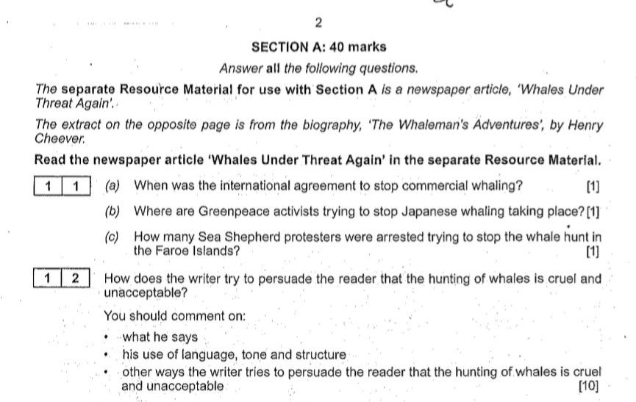
The exam wants to know if you can see how a writer is trying persuade the reader

Slide 3
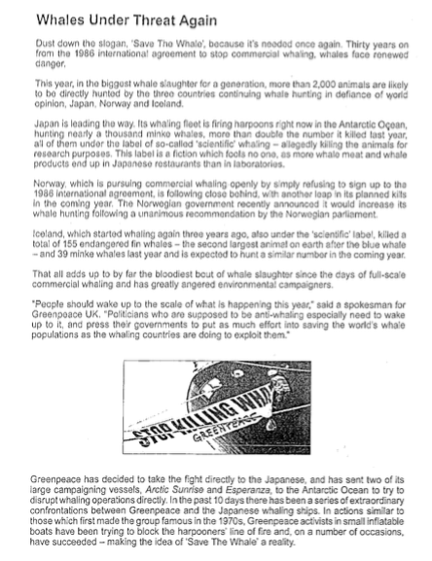
A text may look like this (in fact, this is half of an article from a real exam question)

Slide 4
Let’s take a small section of the text to practise analysing it.
This year, in the biggest whale slaughter for a generation, more than 2000 animals are likely to be directly hunted by three countries continuing whale hunting in defiance of world opinion: Japan, Norway and Iceland.

Slide 5
Let’s take a small section of the text to practise analysing it.
How does the writer try to persuade the reader that the hunting of whales is cruel or unacceptable?
This year, in the biggest whale slaughter for a generation, more than 2000 animals are likely to be directly hunted by three countries continuing whale hunting in defiance of world opinion: Japan, Norway and Iceland.
Q2

Slide 6
HOW is the author persuading the reader?
How does the writer try to persuade the reader that the hunting of whales is cruel or unacceptable?
This year, in the biggest whale slaughter for a generation, more than 2000 animals are likely to be directly hunted by three countries continuing whale hunting in defiance of world opinion: Japan, Norway and Iceland.

Slide 7
HOW is the author persuading the reader?
When you respond to this type of question, you need to include 4 elements in your answer
LT + Q + E + L
Language technique
Link back to question
Explanation
Quote

Slide 8
This is an effective template to shape your answer
When you respond to this type of question, you need to include 4 elements in your answer
LT + Q + E + L
Language technique
Quote
Link back to question
Explanation
The author uses the (LT).................. ’(Q).........................................’ to suggest (E)......................................................................................................................
which is (L) ..........................................................................

Slide 9
So now you know how to answer, now we need to learn what to look for in the text

Slide 10
So now you know how to answer, now we need to learn what to look for in the text
THIS IS WHERE IT PAYS TO KNOW YOUR PERSUASVE LANGUAGE TECHNIQUES
Polemic
argument
Rhetorical
questions
Significant
Statistics
Imperatives
Repetition
Sibilance
Metaphor
Emotive
language
Direct address
Hyperbole
Alliteration
Similes
Rule of 3
Structural
choices
Facts
Experts
Purple = strongest

Slide 11
- Emotive word choices
- Use of significant statistics
- Emotive facts
How does the writer try to persuade the reader that the hunting of whales is cruel or unacceptable?
This year, in the biggest whale slaughter for a generation, more than 2000 animals are likely to be directly hunted by three countries continuing whale hunting in defiance of world opinion: Japan, Norway and Iceland.
Consider:

Slide 12
- Emotive word choices
- Use of significant statistics
- Emotive facts
How does the writer try to persuade the reader that the hunting of whales is cruel or unacceptable?
This year, in the biggest whale slaughter for a generation, more than 2000 animals are likely to be directly hunted by three countries continuing whale hunting in defiance of world opinion: Japan, Norway and Iceland.
Consider:
Possible response
The author uses the emotive word ‘slaughter’ to suggest the killing is very violent and brutal, which suggests it is cruel.
The author also uses significant statistics in ‘2000 animals are hunted’, which is a lot, and suggests that it is unacceptable because killing this many could lead to extinction.
The use of emotive facts: ‘in defiance of world opinion’ is an attempt to single out and identify who is doing the whaling, almost trying to shame them, and implies it is unacceptable.

Slide 13
HOW?
= LT + Q + E + L
Language technique
Explanation
Link back to question
Quote
The author uses the (LT) emotive word (Q) ‘slaughter’ (E) to suggest the killing is very violent and brutal, (L) which suggests it is cruel.
The author also uses significant statistics in ‘2000 animals are hunted’, which is a lot, and suggests that it is unacceptable because killing this many could lead to extinction.
The use of emotive facts: ‘in defiance of world opinion’ is an attempt to single out and identify who is doing the whaling, almost trying to shame them, and implies it is unacceptable.

Slide 14
HOW = LT + Q + E + L
Language technique
Quote
Link back to question
Explanation
Looking deeper
The author uses the (LT) emotive word
(Q) ‘slaughter’
(E) to suggest the killing is very violent and brutal,
(L) which suggests it is cruel.
The (E) explanation really just defines what the quote means, and defines it in terms of how it relates back to the question.
So slaughter = violence = cruel.

Slide 15
- Emotive word choices
- Sarcasm
- Sense of urgency
- Emotive facts
- Challenge
How does the writer try to persuade the reader that the hunting of whales is cruel or unacceptable?
Japan is leading the way. Its whaling fleet is firing harpoons right now in the Antarctic Ocean, hunting nearly a thousand minke whales, more than double the number killed last year, all of them under the label of so-called ‘scientific’ whaling – allegedly killing the animals for research purposes. This label is a fiction which fools no one, as more whale meat and whale products end up in Japanese restaurants than in laboratories.
Consider:
Possible response
The author uses the (LT).................. ’(Q).........................................’ to suggest (E)......................................................................................................................
which is (L) cruel/unacceptable.

Slide 16
How does the writer try to persuade the reader that the sport of Mixed Martial Arts is not a good one?
The death of João Carvalho plays out to the backdrop of an orchestra of screaming, excited fans, many of them children. Some leave their seats to run up to the wire mesh surround. Holding it with both hands they howl into the octagon.
Consider:
Emotive word choices
Metaphor
The author uses the (LT).................. ’(Q).........................................’ to suggest (E)......................................................................................................................
(L) which suggests the sport is not a good one.

Slide 17
- Sarcasm
- Emotive word choices
- Use of significant statistics
- Emotive facts
How does the writer try to persuade the reader that the hunting of whales is cruel or unacceptable?
Iceland, which started whaling again three years ago, also under the ‘scientific’ label, killed a total of 155 endangered fin whales – the second largest animal on earth after the blue whale – and 39 minke whales last year and is expected to hunt a similar number in the coming year.
Consider:
The author uses the (LT).................. ’(Q).........................................’ to suggest (E)......................................................................................................................
which is (L) cruel/unacceptable.

Slide 18
How does the writer try to persuade the reader that the sport of Mixed Martial Arts is not a good one?
Carvalho slumps down by the side of the ring. He is helpless and unable to defend himself. Ward senses his opportunity and falls on to him. He partially holds up the collapsed and dazed Carvalho with his heavily tattooed left arm, which fulfils two functions. It presents a clean shot to the right side of Carvalho’s exposed head and face because he is held off the canvas. Ward also uses his opponent’s body as leverage to get power into his right-handed punches, which rain down.
Consider:
- Emotive word choices
- List like action
- Bias
- Metaphor

Slide 19
- Emotive word choices
- Use of expert (ethos)
- Call to action
- Use of logic (logos)
How does the writer try to persuade the reader that the hunting of whales is cruel or unacceptable?
That all adds up to by far the bloodiest bout of whale slaughter since the days of full-scale commercial whaling and has greatly angered environmental campaigners.
‘People should wake up to the scale of what is happening this year’, said a spokesman for Greenpeace UK. ‘Politicians who are supposed to be anti-whaling especially need to wake up to it, and press their governments to put as much effort into saving the world’s whale populations as the whaling countries are doing to exploit them.’
Consider:

Slide 20
- Emotive word choice
- Contradiction and the response to it
How does the writer try to persuade the reader that the hunting of whales is cruel or unacceptable?
Another marine conservation group, Sea Shepherd, has also been taking direct action to prevent the slaughter of whales in the Faroe Islands, a self-governing nation in the kingdom of Denmark. Although whaling is illegal in Denmark, the annual killing of pilot whales is allowed in the Faroe Islands.
Consider:

Slide 21
- Emotive word choices
- Contrast
- Appeal to morals and values
- Short sentence
How does the writer try to persuade the reader that the sport of Mixed Martial Arts is wrong?
The savagery of Carvalho’s beating and the glee of the young fans, unaware of what was unfolding but nonetheless aroused and stimulated by the extraordinary violence and perhaps now traumatised, will be seen in the broader sense as a calamitous and indefensible episode in Dublin. There is no precedent in organised sport where punching a defenceless opponent nine times on the ground when he has collapsed but is conscious is acceptable. It is crossing the line.
Consider:
Calamitous = causing great confusion and disorder
Precedent = coming before/ setting a standard

Slide 22
- Emotive word choices
- Contrast
- Appeal to morals and values
- Short sentence
How does the writer try to persuade the reader that the sport of Mixed Martial Arts is wrong?
The savagery of Carvalho’s beating and the glee of the young fans, unaware of what was unfolding but nonetheless aroused and stimulated by the extraordinary violence and perhaps now traumatised, will be seen in the broader sense as a calamitous and indefensible episode in Dublin. There is no precedent in organised sport where punching a defenceless opponent nine times on the ground when he has collapsed but is conscious is acceptable. It is crossing the line.
The author uses the emotive word savagery in describing the beating to evoke a sense of violence connected to the ‘beating’, another emotive word, which indicates he is against MMA.
He calls the violence ‘extraordinary’, which means it is unique, again indicating he is against the sport.
He uses the short sentence at the end of the text to add emphasis to his view that the sport is wrong, as it suggests that the violence has gone too far.
He uses the emotive word ‘traumatised’ to suggest the children watching the event have been potentially mentally scarred by the violence, which indicates he is against MMA.
The author reiterates/uses repetition of the number of punches endured by the man to emphasise the unacceptable large amount of punches, proving he is against MMA.
Consider:
Calamitous = causing great confusion and disorder
Precedent = coming before/ setting a standard

Slide 23
- Emotive word choices
- Significant statistics
- Use of ethos
How does the writer try to persuade the reader that the hunting of whales is cruel or unacceptable?
As many as 250 whales were reportedly massacred on two beaches in the Faroe Islands in July, where locals savagely killed all of the pilot whales. The horrific scenes were filmed by activists from Sea Shepherd and published on the internet. The film footage shows how the innocent whales were herded inshore by small boats and forced to swim towards the beaches.
Consider:

Slide 24
- Emotive word choices
- Appeal to justice
How does the writer try to persuade the reader that the hunting of whales is cruel or unacceptable?
The locals, many of whom were dressed in full wetsuits, waded into the water and violently dragged the distressed animals up the beach, where they were ruthlessly slaughtered. Five members of the Sea Shepherd group were arrested as they tried to stop the gruesome spectacle.
Consider:

Slide 25
- Emotive word choices
- Appeal to justice
How does the writer try to persuade the reader that the hunting of whales is cruel or unacceptable?
The captain of one of the Sea Shepherd boats said he believed two Danish naval vessels were in the area when the hunt took place. He said, ‘It was perfectly clear to me that the slaughter proceeded with the full consent of the Danish Navy.’
Consider:

Slide 26
- Emotive word choices
- Appeal to justice
- Bias
How does the writer try to persuade the reader that the hunting of whales is cruel or unacceptable?
How much longer can the government of Denmark continue its arrogant support of this bloody practice, which is in direct conflict with its commitments to international law? All decent people should see that the hunting of whales is cruel and unacceptable.
Consider:

Slide 27
- Emotive word choices
- Contrast
How does the writer try to persuade the reader that the balloon flight was difficult?
We were zipping across the tree tops at 25 knots. I warned him that our landing might be difficult but he didn’t seem worried. I prayed to the wind gods. Luckily, we managed a stand-up landing and he survived to tell the tale.
Consider:

Slide 28
- Emotive word choices
- Superlatives
- sentence structure
How does the writer try to persuade the reader that the balloon flight was enjoyable?
Then, as we floated gently along below the still cloudless skies, and above the fields in a line with the Thames towards Richmond, and looked over the edge of the basket in which we were standing, the sight was the most exquisite visual delight ever experienced.
Consider:

