Slide 1
WORD CHALLENGES
For me, one of the most powerful strategies in the English classroom is getting students to write. Analysing texts is extremely important, but getting students to experiment with words themselves seems to enhance their ability to analyse other peoples' writing.
These activities are designed to allow students to explore the way words change in meaning depending on how they are arranged or communicated. There are a wide range of activities including those connected to the mechanics of language, and others more reliant on creativity. The rationale is that by continually experimenting with words in these short engaging activities, students attain a better appreciation of their use.
Teachers are encouraged to alter the activities to suit a relevant theme or topic of a lesson.
Rarely have these activities not resulted in the entire class absorbed in learning.

Slide 2
REARRANGING WORDS
These activities are designed to build capacity to construct complex sentences. If students can develop and construct complex sentences, not only are they more than halfway there to becoming successfully literate in our culture, but they will be better able to write stronger responses in creative writing challenges, as well as becoming better equipped at analysing fiction and non-fiction texts.
Don’t assume students know what subordinate clauses are. You will no doubt have to teach it, incorporating relative clauses and a list of subordinating conjunctions. Once they have this knowledge, students will thrive in experimenting with their choices to manipulate sentences for meaning.

Slide 3
Combine into 1 sentence - Using subordinating connectives
Strategy: have slide with 1 example to get started, then next slide should have 3 examples to accommodate different strengths in class.
John ate his dinner.
He reminisced about his childhood.
A feeling of great contentment enveloped him.
Answers
After John ate his dinner, he reminisced about this childhood, and a feeling of great contentment enveloped him.
Or,
As John ate his dinner …....
Or
While John ate his dinner
etc
Notes:
Using subordinating conjunction. After John ate his dinner, he reminisced about this childhood, and a feeling of great contentment enveloped him.
Or, As John ate his dinner …....
Or While John ate his dinner
etc

Slide 4
Combine into 1 sentence
Combine into 1 sentence - Using subordinating connectives
They marched towards the line.
The army lost hope.
They fired non stop.
The clouds quickly parted.
Sarah looked over with glee.
Beams of light shone on his face.
New places always excited him.
Freedom seemed to appear from nowhere.
Onwards he ran.
Notes:
Using relative clauses, subordinate clauses

Slide 5
Combine into 1 sentence - Using relative clauses ‘whose’, ‘who’, ‘which’ or ‘that’.
Strategy: have slide with 1 example to get started, then next slide should have 3 examples to accommodate different strengths in class.
They watched men die.
The generals were stubborn
They showed no remorse.
Answers
The generals, who watched men die, were stubborn and showed no remorse
Or
The stubborn generals, who showed no remorse, watched men die.
etc

Slide 6
Combine into 1 sentence - Using relative clauses ‘whose’, ‘who’, ‘which’ or ‘that’ and connectives.
Conscientious dissenters were brave.
They didn’t want to fight a rich man’s war.
They were ostracized from the community
The space shuttle is a rocket. The rocket is manned. This rocket can be flown back to earth. This rocket can be reused.
The boat sailed on.
The sail was broken.
The seas grew very large and very dangerous.

Slide 7
Turn into 1 sentence any way you can
Samantha danced on the roof. It was the roof of her trailer.
Samantha danced during the thunderstorm. The thunderstorm flooded the county. The thunderstorm was last night.
The man handed me a photograph of a woman. He did this silently. The man was old. The woman was beautiful.
Willie had a beard and a moustache. The beard was bushy. The beard was long. The moustache was droopy.
The man handed me a photograph of a woman. The photograph was torn. The photograph was faded. The woman was young.
Notes:
Longer sentences – 4 examples

Slide 8
Turn into 4 sentences – omitting connectives and relative clauses
Because the situation was becoming clear, Martha, who was regaining her strength, smiled, as she knew her best friend was actually still her best friend.
Notes:
Reversed process – can omit conjunctions only.

Slide 9


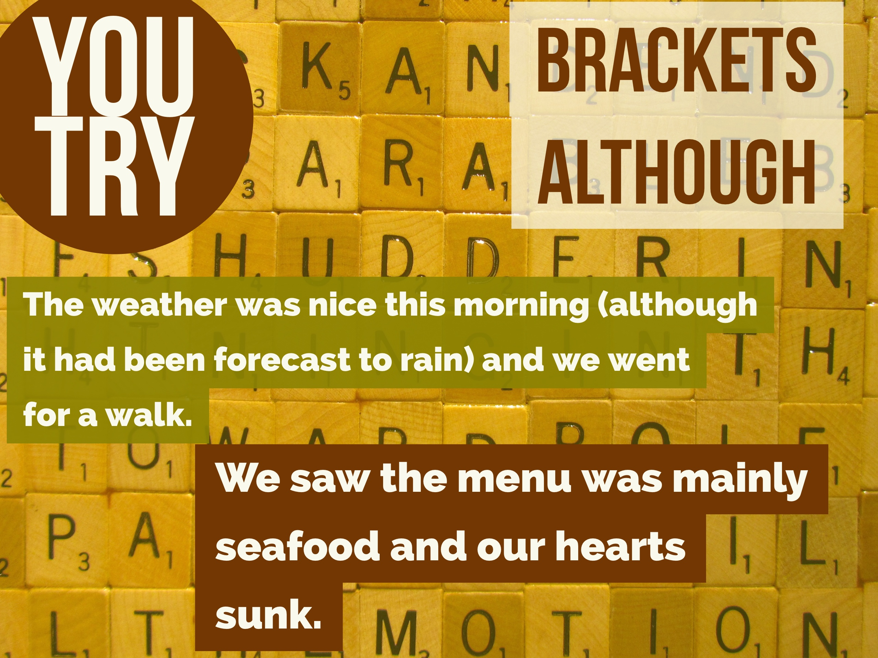
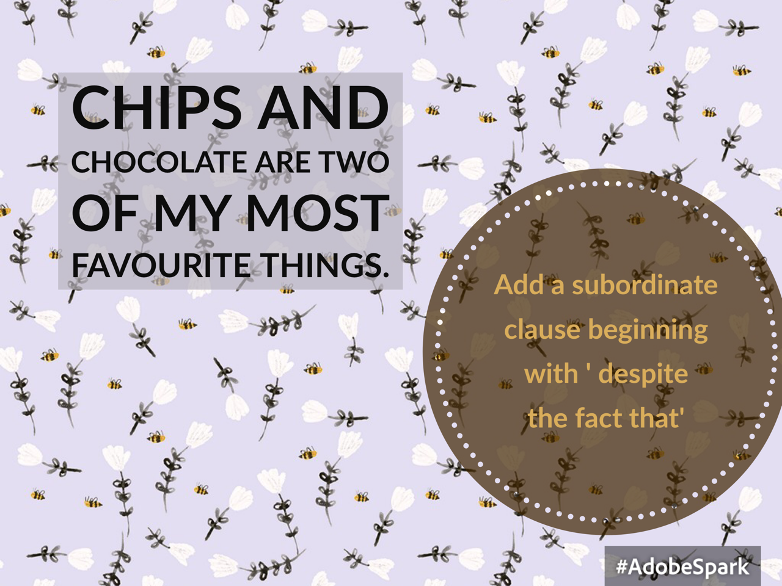
We sat in the movie theatre
sobbing quietly.
Add a subordinate clause
using the words ‘even though’
Even though the rain fell incessantly, we kept on going
Notes:
Adverb clauses of concession: however, despite the fact that, although, while, even though.
Thanks to @heymrshallahan for Brackets/although example
Created using Spark post

Slide 10
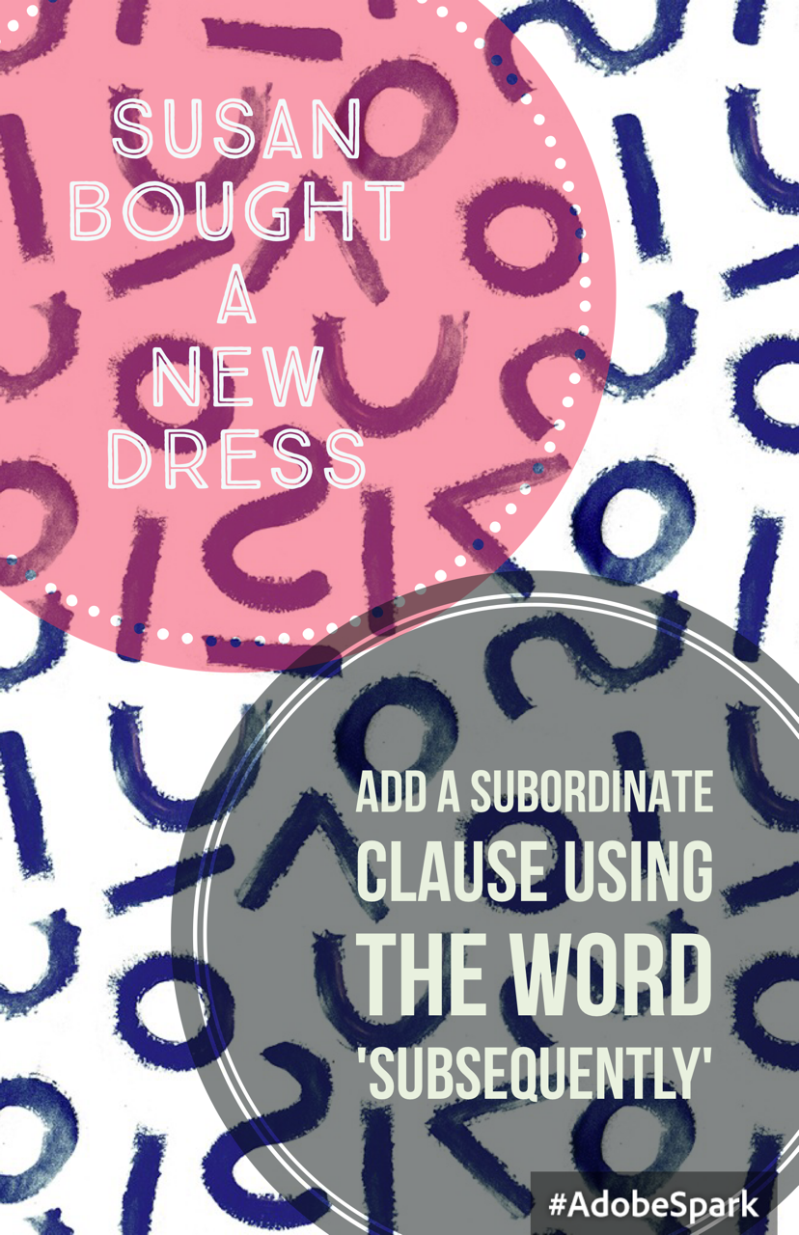
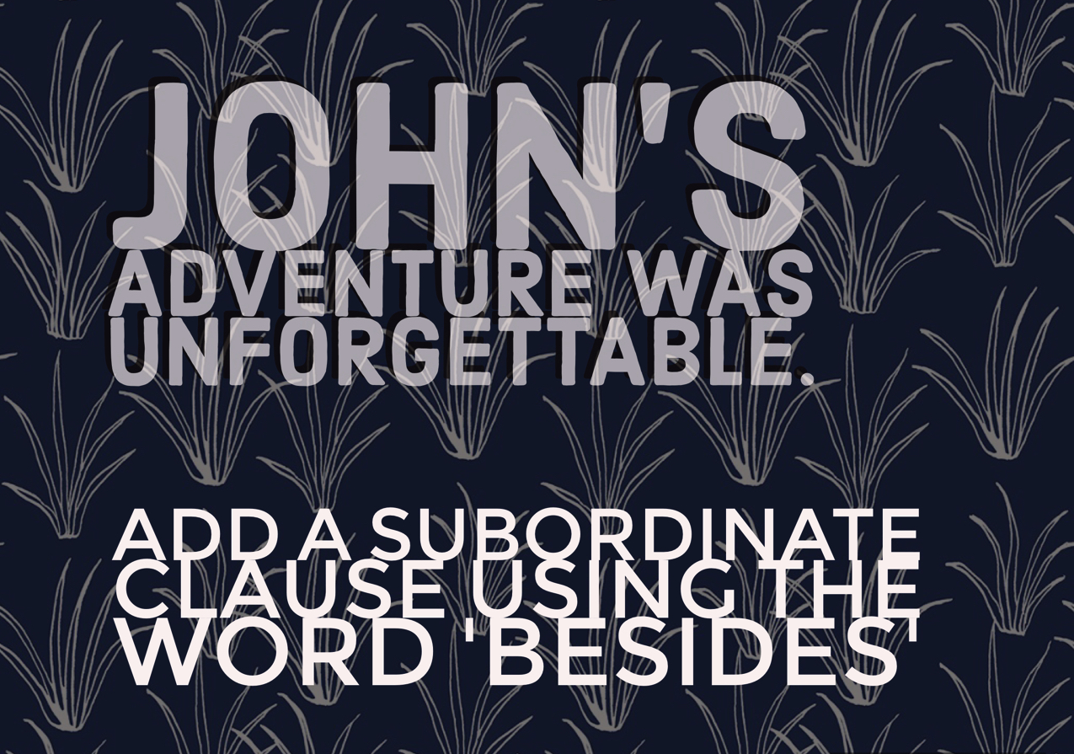

Slide 11
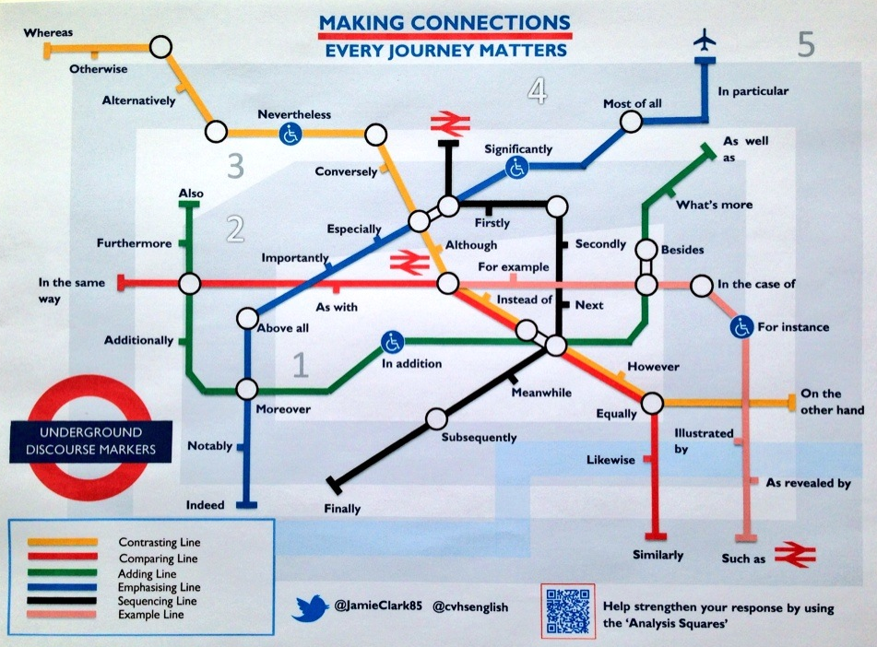
Choose a ‘connective line’ and choose 3 connectives. Write 3 sentences that incorporate the connective chosen.
Change the connective in each sentence with one from another ‘line’, and comment on the effect.

Slide 12
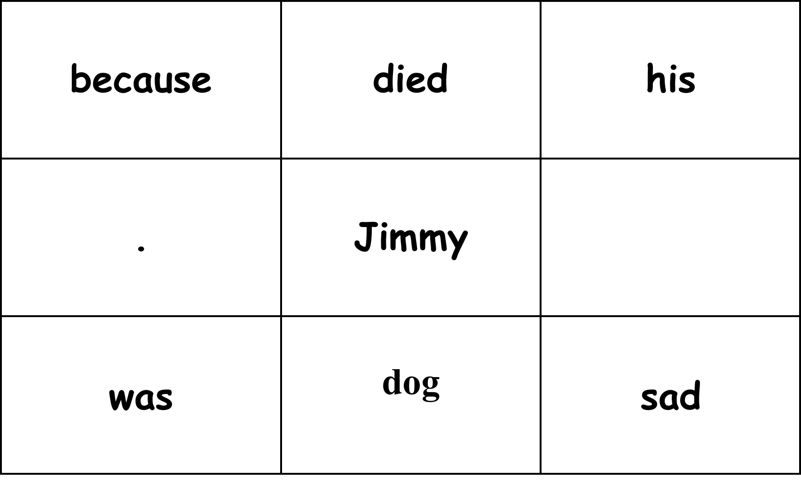
Rearrange back into correct order
Notes:
Jimmy was sad because his dog died.
Add a word in the box

Slide 13
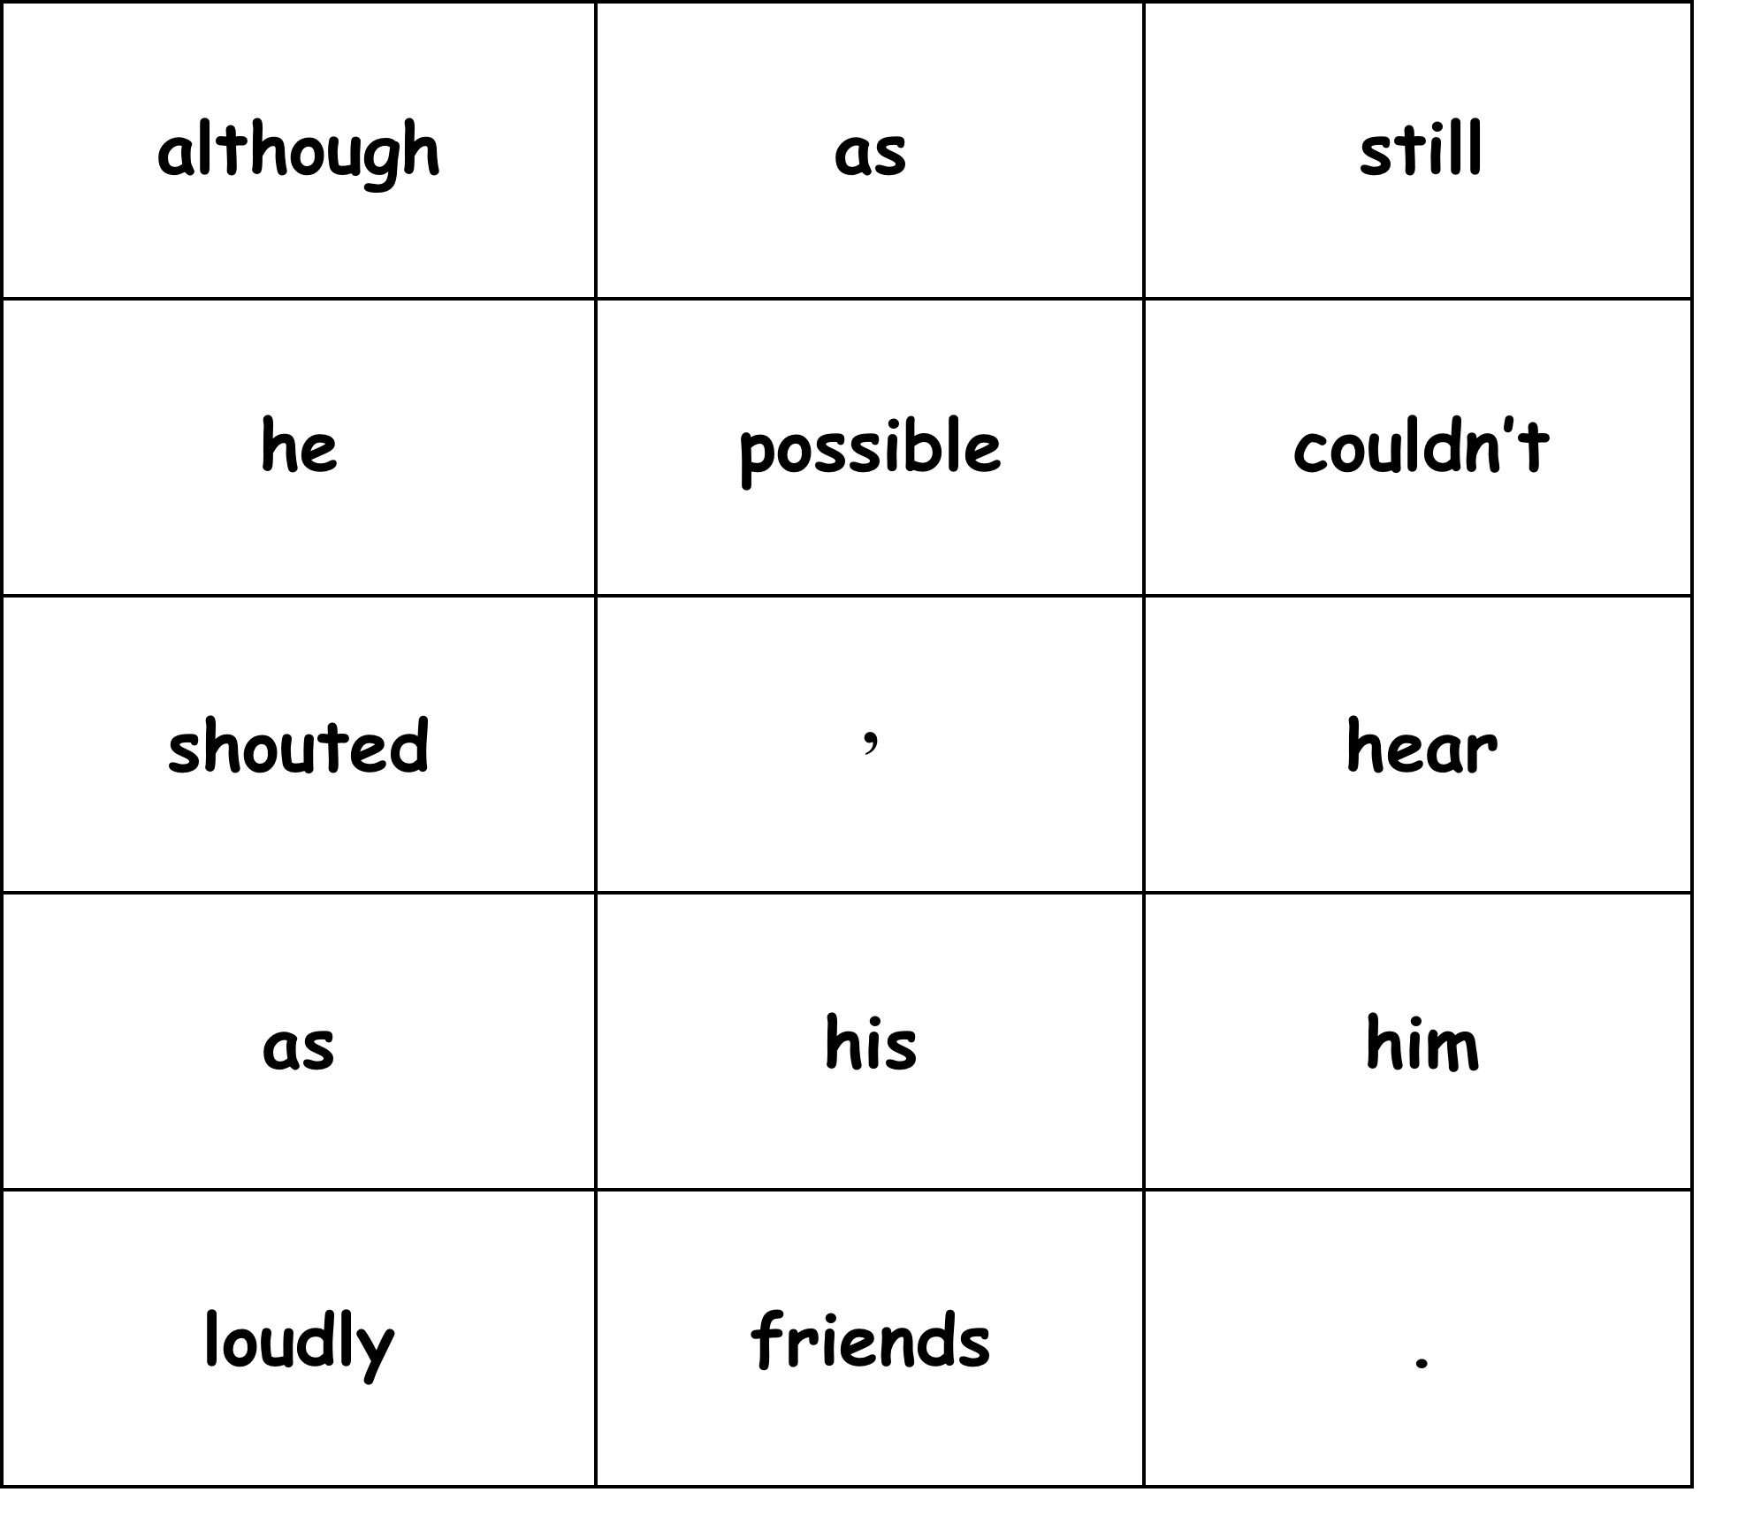
Notes:
Although he shouted as loudly as possible, his friends still couldn't hear him.

Slide 14
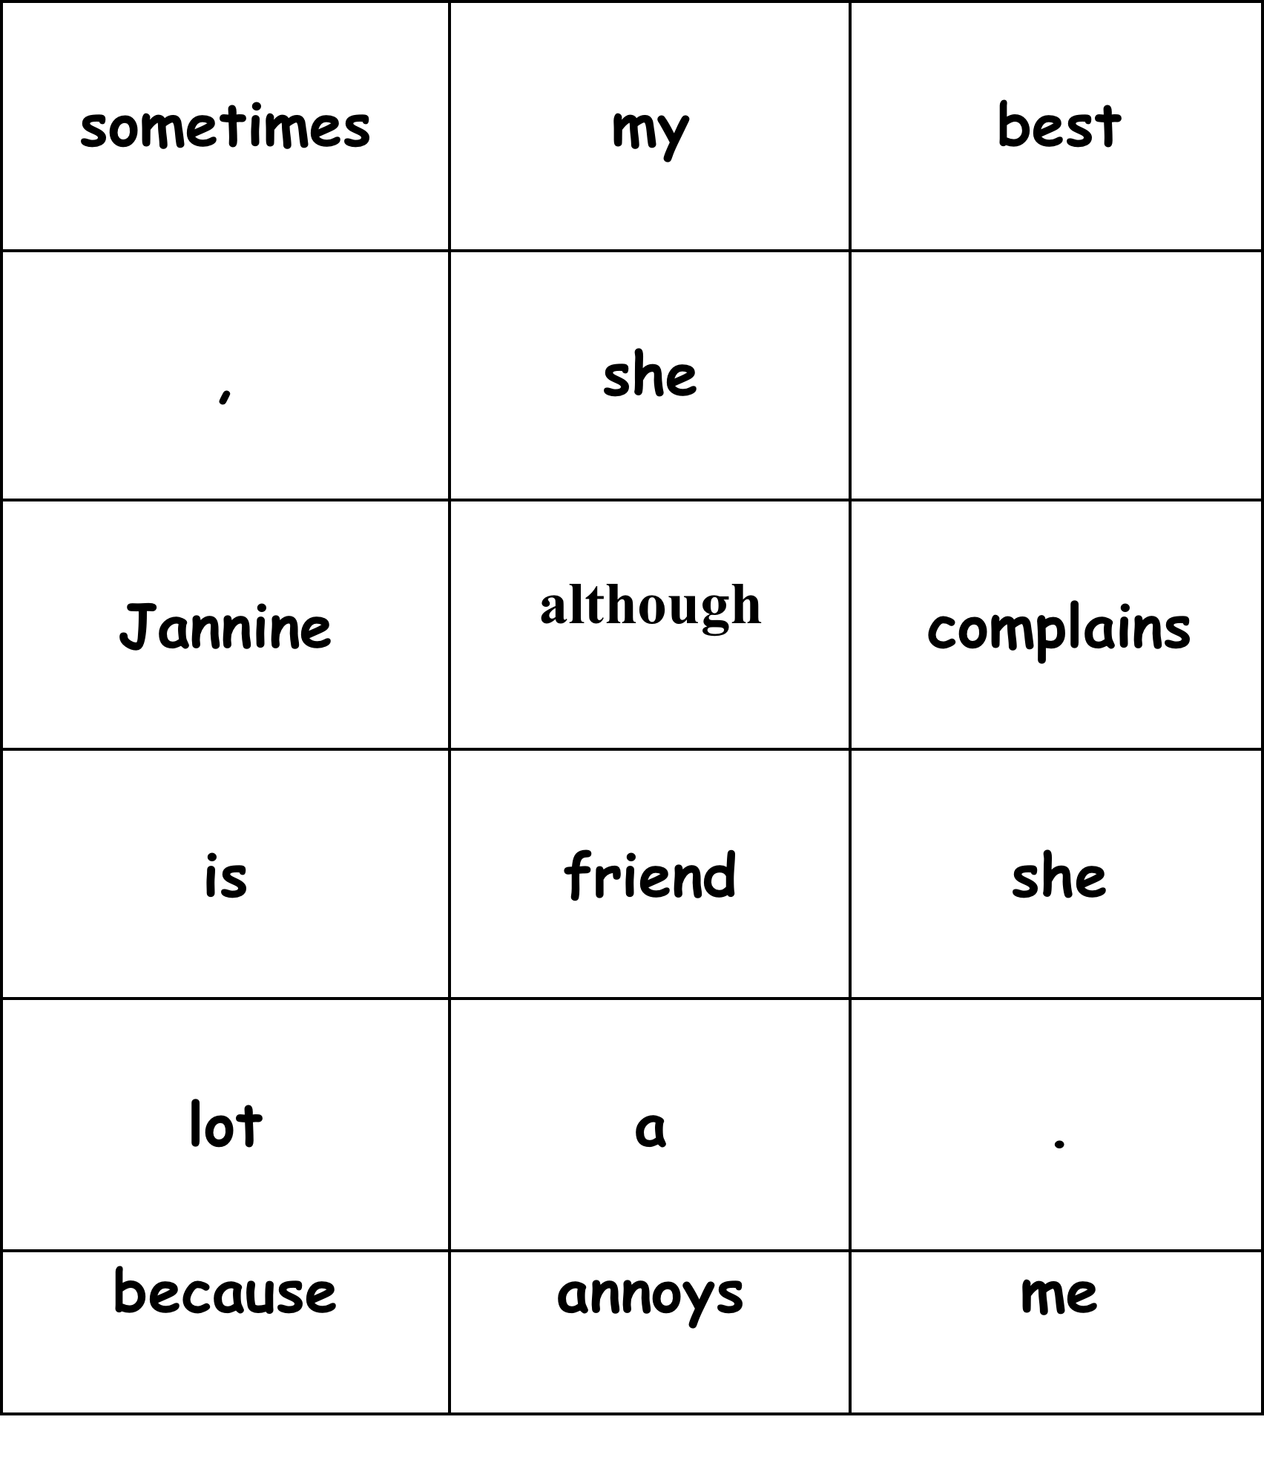
Notes:
Although she is my best friend, Jannine sometimes annoys me because she complains a lot.

Slide 15
Muddled sentences
Read out the words of a sentence in the incorrect order.
Students write down what they hear and then rebuild into the right order.
Notes:
e.g.
his ate jaguar finally prey the
Thanks to Maria Freestone: aka @incathecat

Slide 16
MEMORY
Training students to use memory is a great way to develop and strengthen it.
Notes:
All memory activites thanks to Maria Freestone: aka @incathecat

Slide 17
MEMORISE then put in alphabetical order
F G T P Q
L P T Y R E C W S
Notes:
Thanks to Maria Freestone: @incathecat
Teach ways to help chunk info

Slide 18

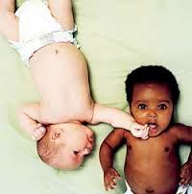
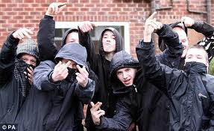
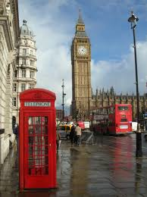


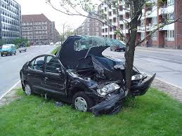
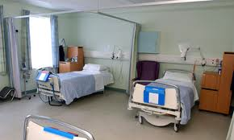
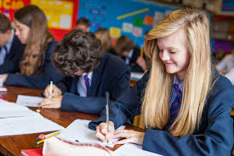
Notes:
Focus on images because one of them is about to change. These tasks teach students to be attentive, a vital skill in English, and school and life in general.

Slide 19
Notes:
One image removed

Slide 20
Notes:
Images rearranged

Slide 21
Notes:
revealed

Slide 22
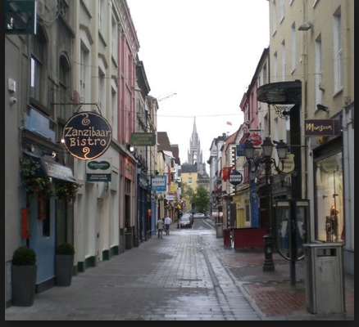
Notes:
Next slide asks questions of what’s in the image. Can be differentiated to be easier by using simpler image.

Slide 23
Test your memory
How many litter bins are there?
What is the weather like? Explain how you know for a bonus point.
How many plants in pots are there?
How many light posts?
What is the name of the Bistro?
How many people can you see?
Notes:
Build skill by having less questions to begin with

Slide 24
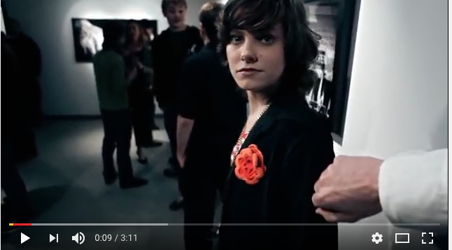
Using music videos
What type of flower is on the girl’s jacket?
What is written on the note the man gives her?
What does she do with it?
Etc etc
Notes:
Using really cool movie videos is an excellent way to train attentive viewing. Develop 10 questions per video, and observe how students get better at the process of being attentive. The best chips are those whose theme links to the lesson.

Slide 25
THUNKS
Thunks possibly work best once students are secure in their knowledge of a particular or specific context. The problems or sometimes paradoxes posed with these types of questions certainly stimulate thinking and can be a very powerful way to extend students’ understanding of topics.

Slide 26
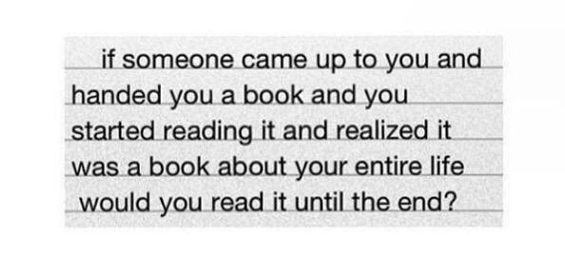
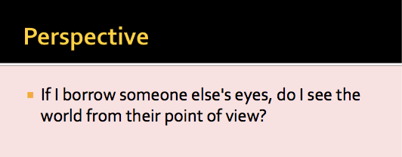
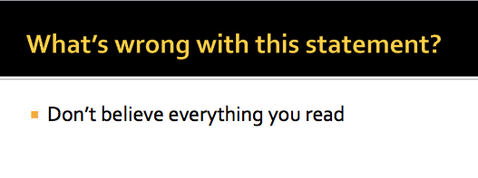
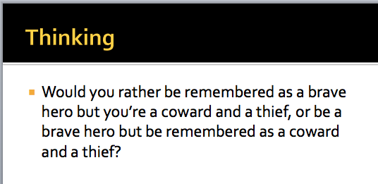
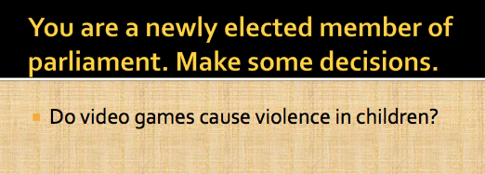
Notes:
Lots here: http://www.thunks.co.uk/Default.aspx?CategoryID=0&Page=34
5 min writing activity, or debate

Slide 27
design your own thunk

Slide 28
DEFINITIONS
Most people in our culture simply bypass an understanding of words that are used repeatedly in the language. Drawing students attention to the meaning of these very common words serves as an interesting activity, challenges their thinking, and seems to empower them in the process.

Slide 29
WHAT DO THESE WORDS MEAN?
OF
THE
AN

Slide 30
WHAT DO THESE WORDS MEAN?
BECAUSE
THEREFORE
HOWEVER

Slide 31
WHAT DO THESE WORDS MEAN?
IF
SOMETIMES
ALTHOUGH

Slide 32
DEVELOPING VOCAB
Sophisticated vocab is powerful, but needs to be memorised, and used in new contexts for it to really sink in. Frequent testing is an effective way to help this process, but there are other ways too.

Slide 33
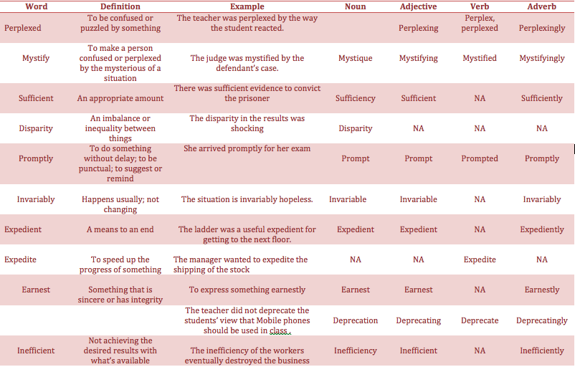
Notes:
Students can memorise words: use tests on definitions, spellings, and then get students to write new examples of the words but using a different word class. This will reinforce the meanings for the students.

Slide 34
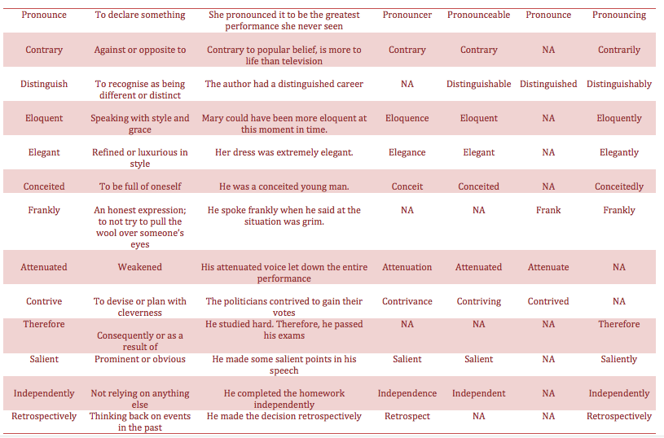
Notes:
Students can memorise words: use tests on definitions, spellings, and then get students to write new examples of the words but using a different word class. This will reinforce the meanings for the students.

Slide 35
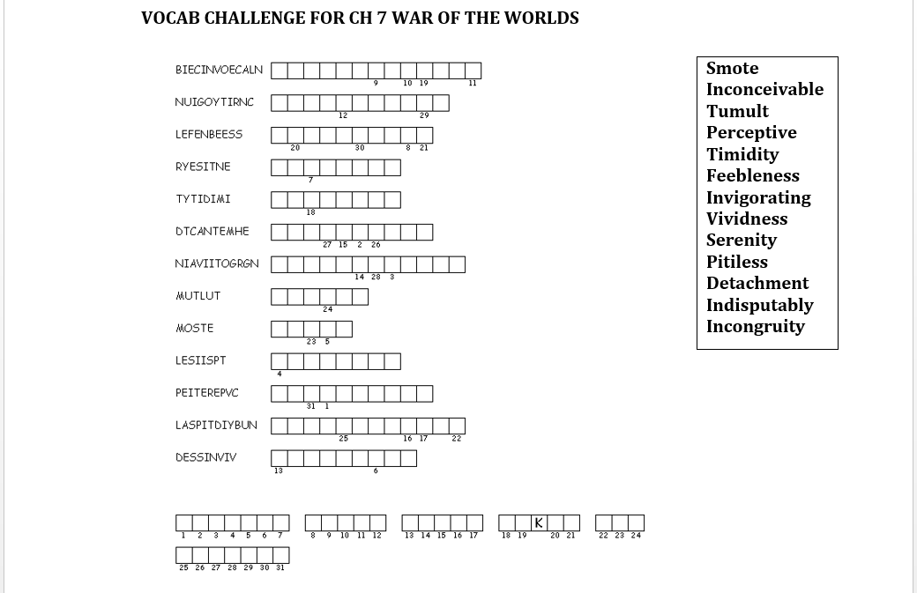

Slide 36
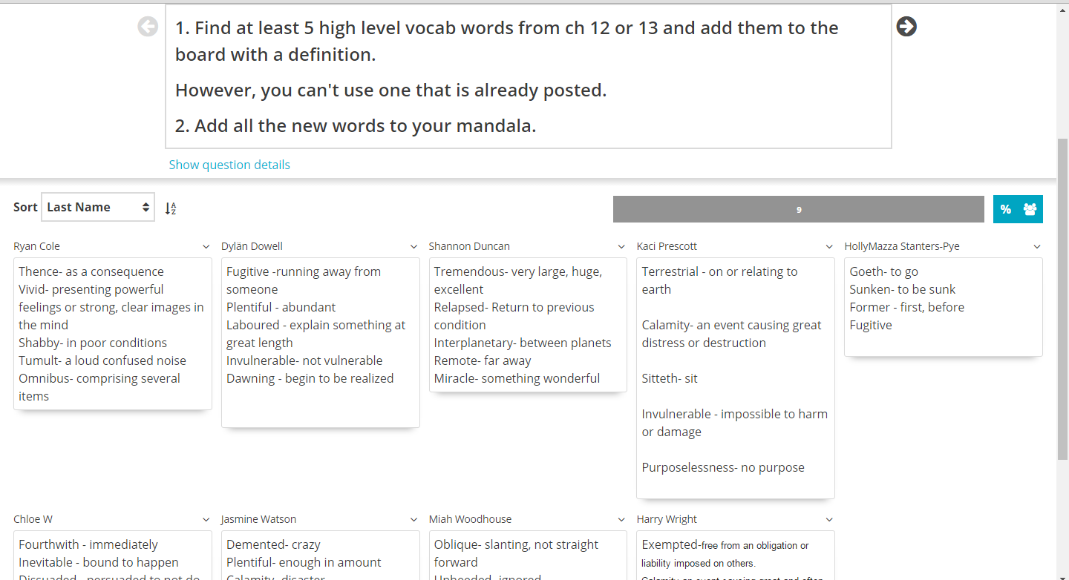
Notes:
Goformative task.
Excellent because once a word was added it couldn’t be replicated. Students ended up looking up more words, developing vocab.
Have students write words in sentences

Slide 37

Choose 4 words and write them in a sentence each
Torrent = rushing violent unceasing stream of something
Formidable = causing fear because of its strength
Diminishing = reducing in size
Gaunt = thin, bony, haggard, grim
Obliquely = not straight, indirectly stated
Receding = retreat, becoming more distant
Inarticulately = not clear in expression
Impetus = momentum, or moving force

Slide 38
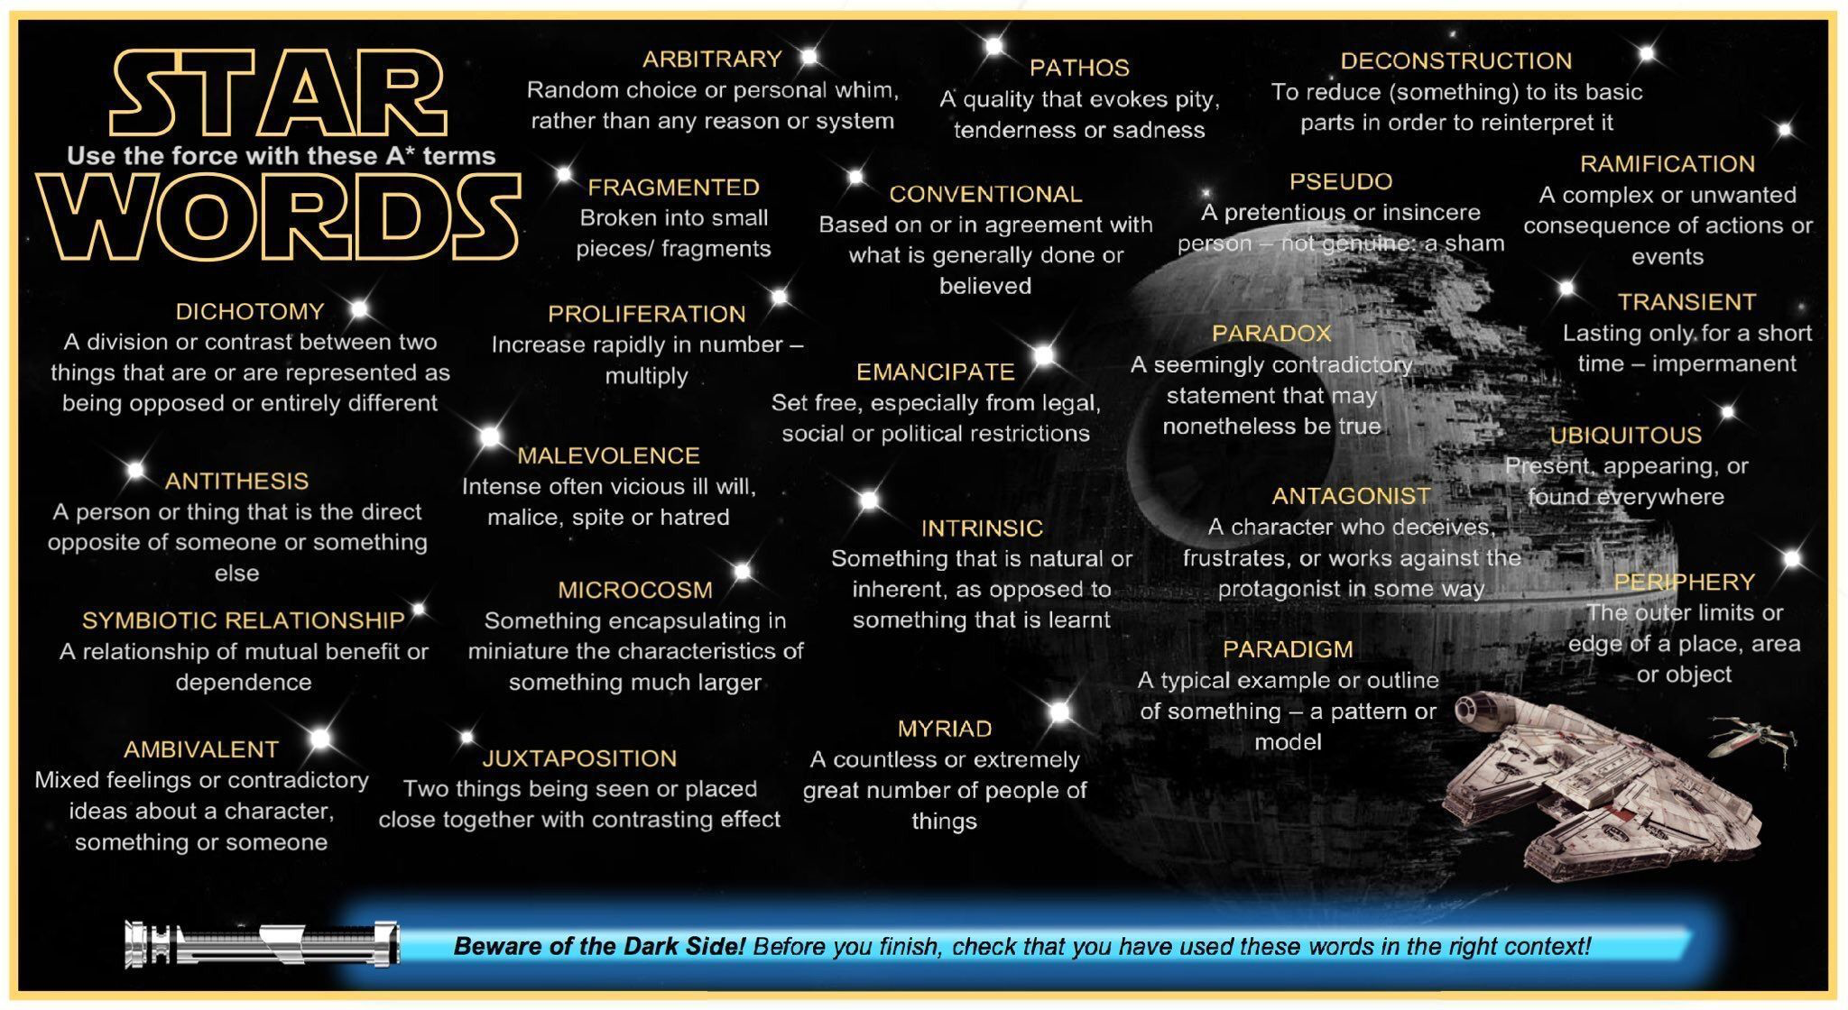
Choose 5 of these words. Compose 5 sentences using each word.
Notes:
THANKS TO https://twitter.com/JamieClark85

Slide 39
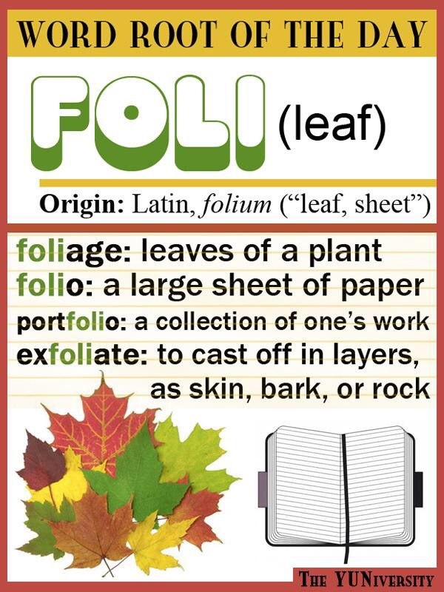
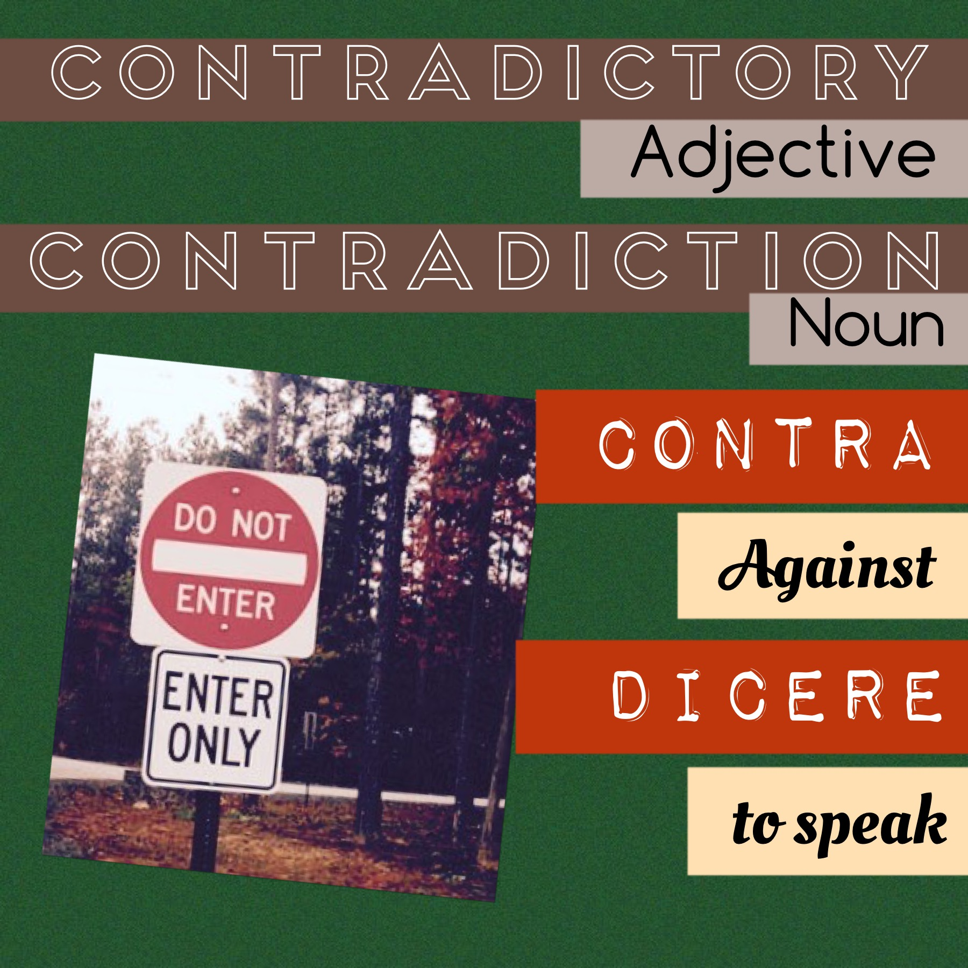
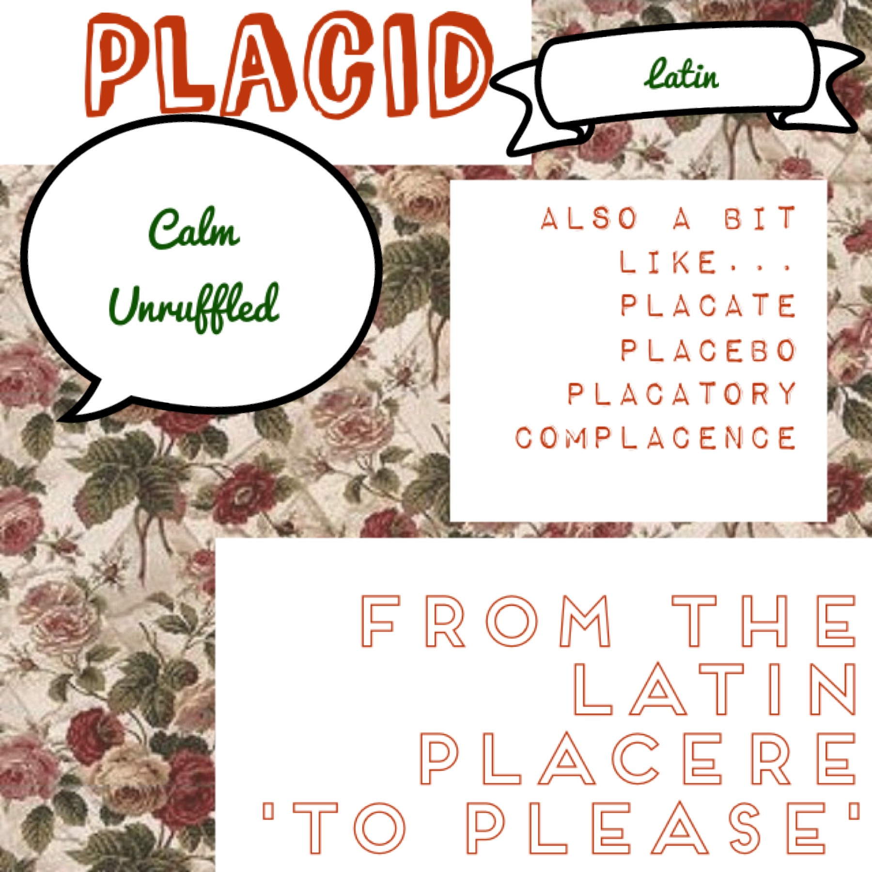
Use a word from each of these ‘root’ words in one complete sentence
Notes:
Thanks to Yuniversity.com

Slide 40

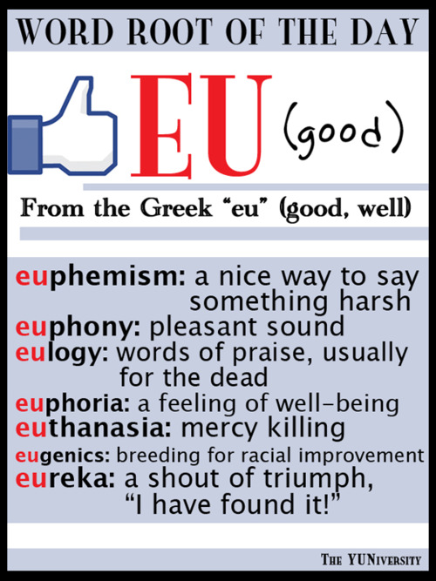
Use a word from each of these ‘root’ words in one complete sentence
Notes:
Thanks to Yuniversity.com

Slide 41
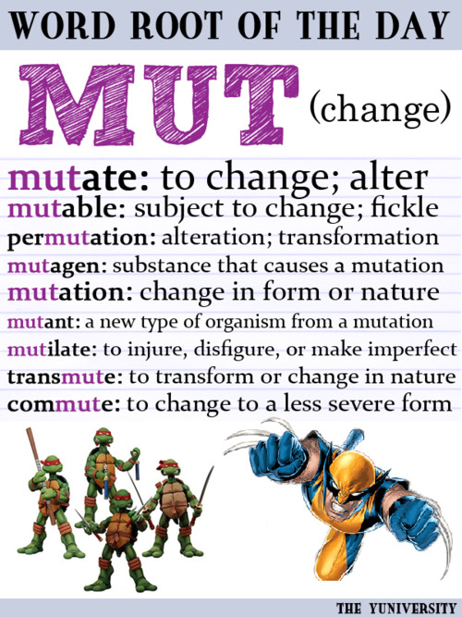
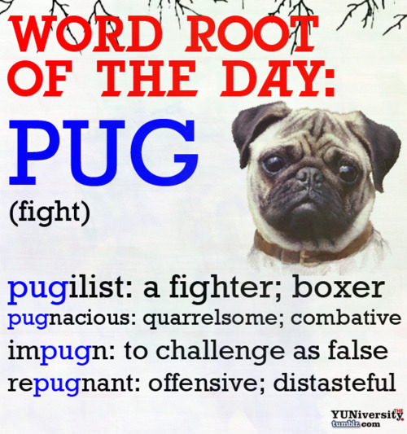
Use a word from each of these ‘root’ words in one complete sentence
Notes:
Thanks to Yuniversity.com

Slide 42
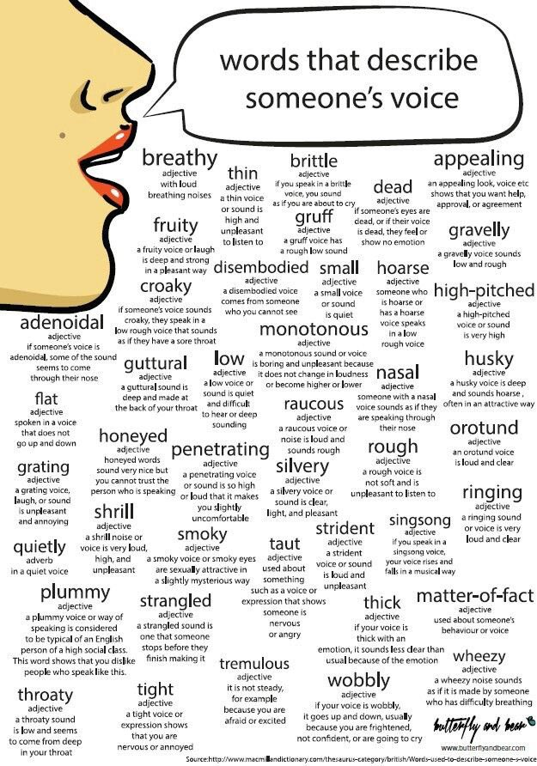
Use these words to write dialogue for a play script
Notes:
Determine the number required to be used. The new vocab provides more depth of thinking for stories.
Attributed to butterflyandbear.com, and shared by @ictevangelist

Slide 43

Interactive Online quizzes
Notes:
This will be constantly growing. Click on image to go to site

Slide 44
CREATIVE thinking
Making creative connections between words. These activities develop fluency and have enormous potential for differentiation; each activity should stretch students’ vocabulary and understanding of word classes.

Slide 45
Simon
7 words
5 words
irreversible
iPod
6 words
Notes:
Short stories – begins with Simon, with 7 words in-between that and the word ‘dinner’, and 6 words in-between irreversible and ipod etc. Story ends with Simon.

Slide 46
Word ladders
night
emperature
Criteria could include:
Words must be > 4 letters; high level vocab from lists; adjectives only; related to a specific topic etc.
X 15
ventual
urid
isingenuous
Notes:
Create a word ladder with 15 words in it

Slide 47
Yellowillingenerousaviourigouraremphaticollaboratessentiallovingl
X …….
you choose number of words
Notes:
Yellow willing generous saviour rigour etc - students use last letter of each word to begin new word, and last word must end with first letter that began circle, or some other shape.

Slide 48
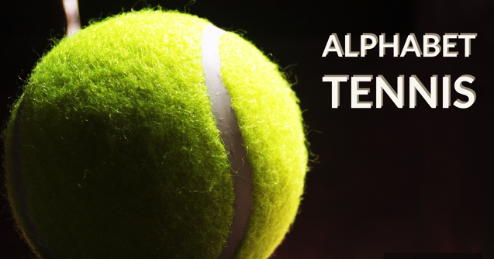
Notes:
Like the class up into two teams. The game is like a game tennis so one team will offer their answer and then it will move over to the second team to respond. The first team begins with a word that starts with the letter A, and team two Will also say a word that starts with A. this continues until one of the teams gets it wrong or can’t think of a word. A point is awarded to the team who didn’t get it wrong. Once an error is made, the next player in turn should move on to the next letter. Basically, each time an error is made the next response must be the next letter. This ensures that students are paying attention, Because often they will just continue with the same letter which is incorrect. Sometimes this may result in three or four errors in a row, with only the very attentive student realising what letter it should be next.
Differentiation is easy on this game: students can only use words more than five letters; words must be nouns; verbs; Adjectives etc. This game works every single time. The hardest thing will be stopping.

Slide 49
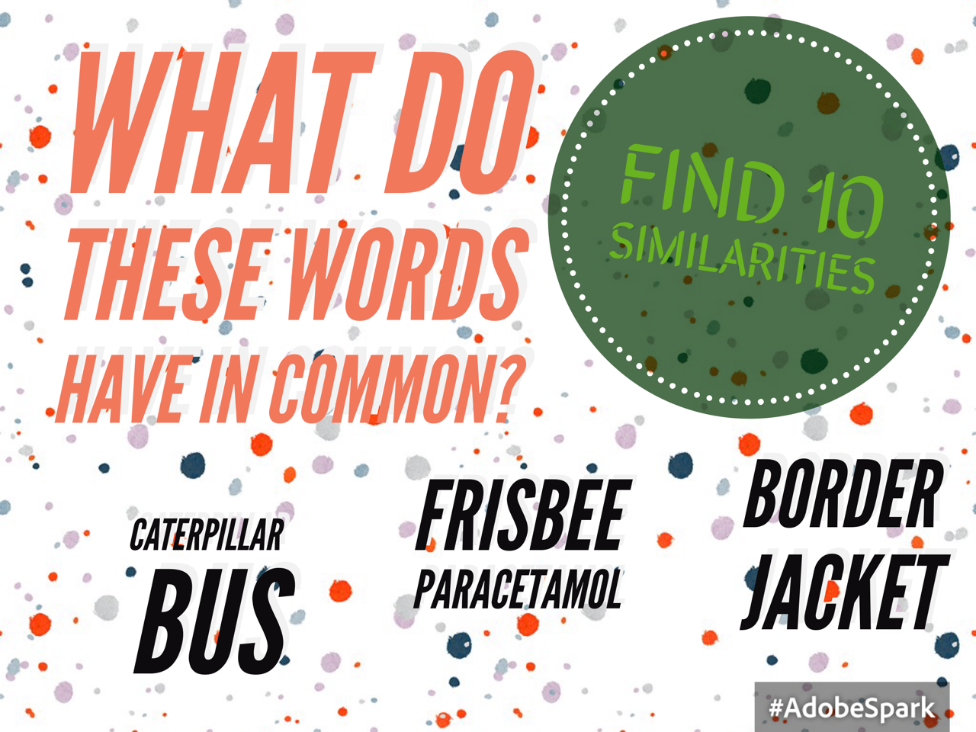
Notes:
3 ACTIVITIES:
1 - Both move, both can have people on them, can both be green etc
2. BOTH CAN BE ROUND, ETC

Slide 50
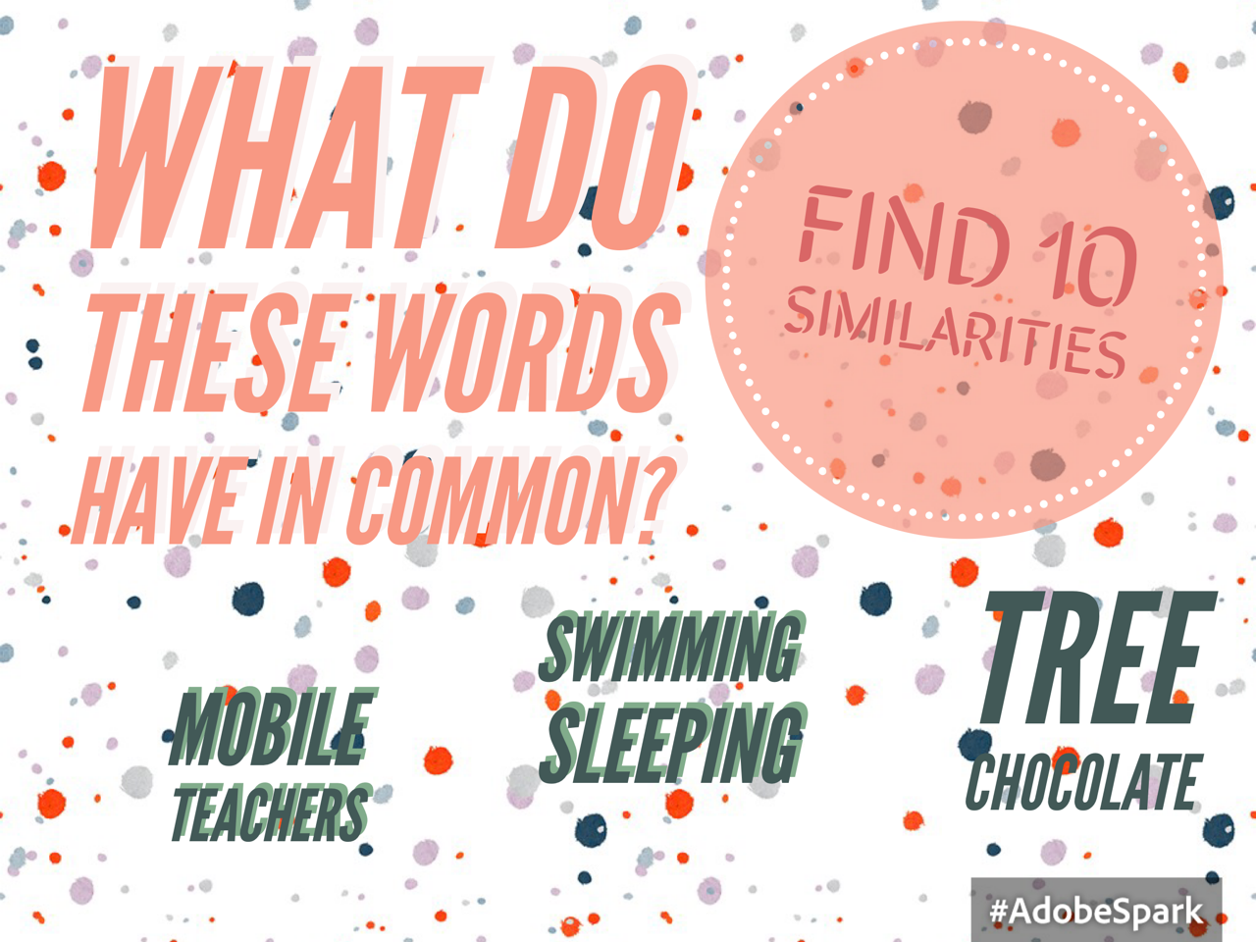
Notes:
3 DIFFERENT ACTIVITIES HERE

Slide 51
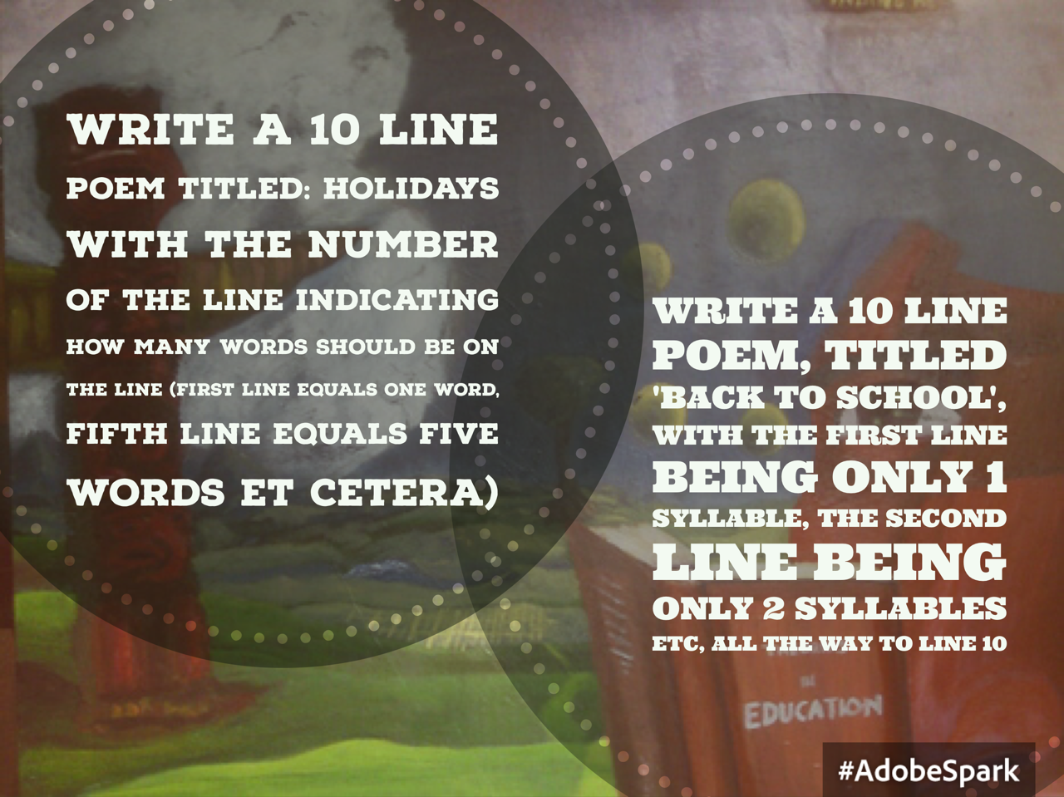
JOY!
Most days
The sun shone
…... .... .... .......

Slide 52
Creative writing
Tapping into a natural desire and love of creative writing is incredibly effective in building writing skills. Students tend to write the best stuff when they are free to just write, with no restrictions. Sometimes it’s best to not Mark the work, but simply provide feedback that points out the strengths of the writing. Students will intuitively develop this strength, Whilst maintaining Great enjoyment in the process.
Providing students with mood vocab is a brilliant way for sophisticated vocab to ‘stick’.

Slide 53
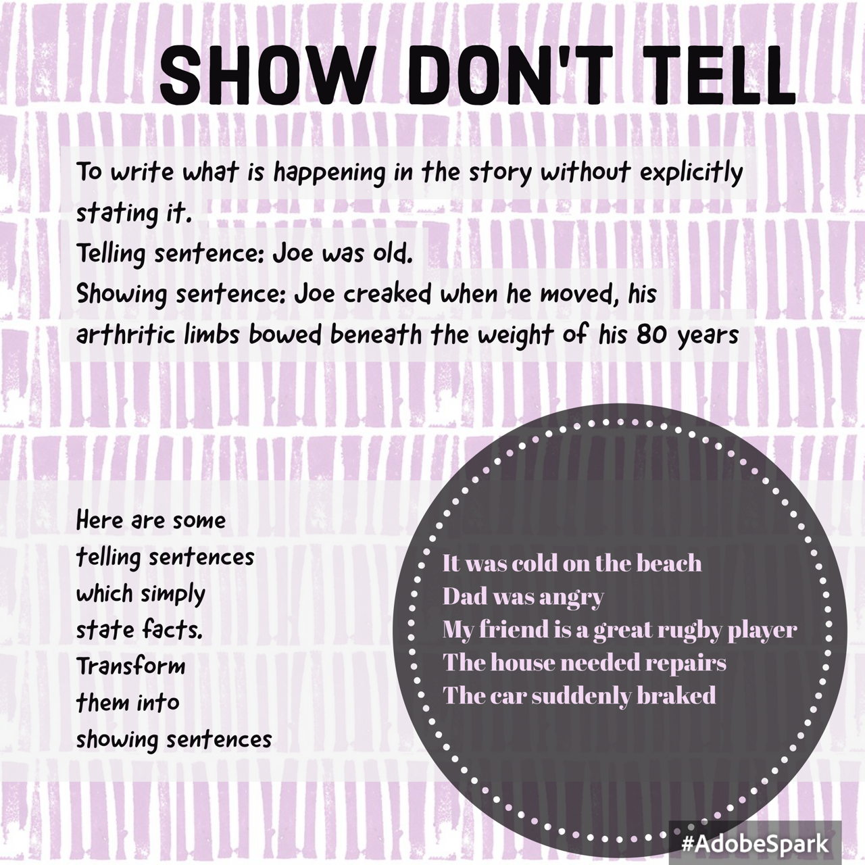

Slide 54



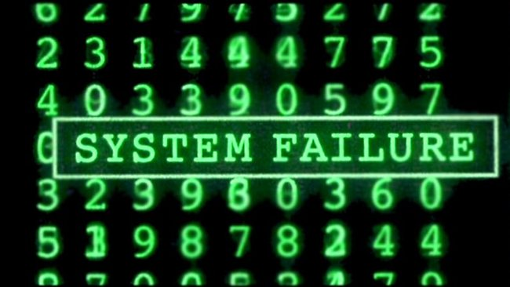
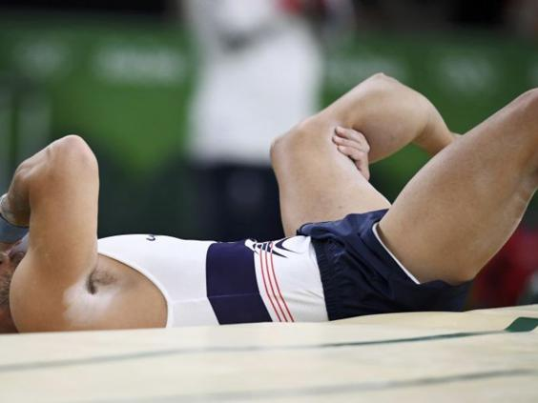

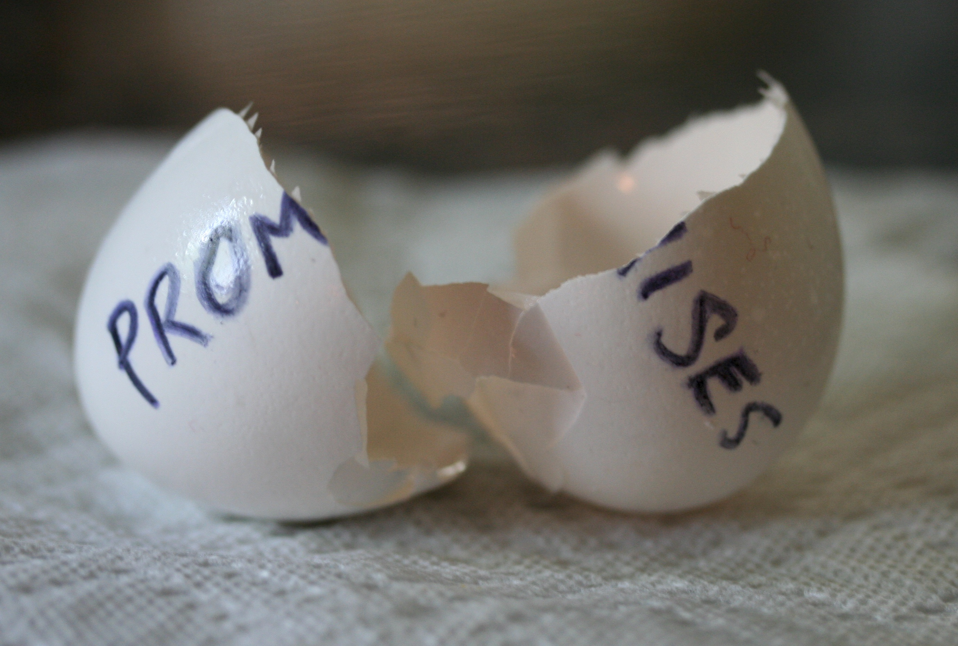
WRITE A 100 word STORY WITH THIS AS THE THEME
Notes:
WRITE A 100 word STORY WITH THIS AS THE THEME

Slide 55

WRITE A 100 word STORY WITH THIS AS THE THEME
Notes:
Write a story titled …..

Slide 56
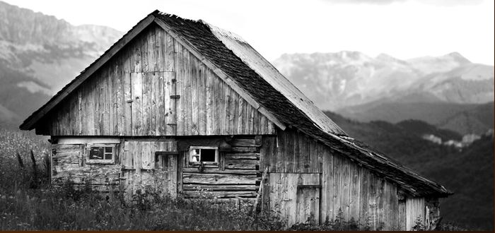
WRITE A 100 word STORY WITH THIS AS THE THEME
Notes:
Write a story with this image as stimulus

Slide 57
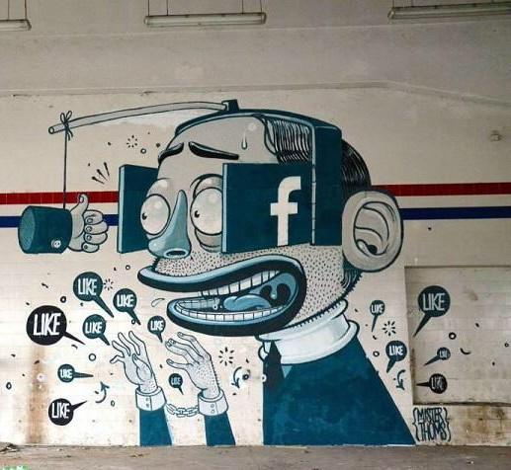
WRITE A 100 word STORY WITH THIS AS THE THEME

Slide 58
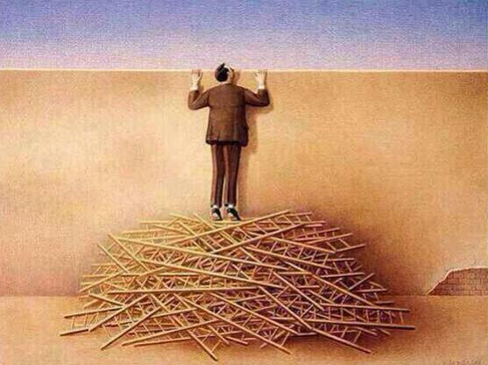

WRITE A 100 word STORY WITH either of THESE AS THE THEME

Slide 59
Identifying
Increase parsing ability by getting students to identify word classes in sentences using interactive activities.

Slide 60
Adjectives
Select all the adjectives from each passage. The first letter of each will provide the clue as to where the envelope is located. The last one however is jumbled up – you’ll have to sort out the letters to make out the 5 words (hint: 1st word starts with p, 2nd with p, and last word is 5 letters long).
The pounding rain poured through the ruined roof. The insipid bucket could hardly perform its necessary function, and a total catastrophe was a certainty. The situation was impossible, and the never-ending growing storm outside was fuming like a stern schoolmaster. Every family member desperately sought to come up with a real solution, a valuable solution that could end the inevitable demise of the cherished games room. The eternal optimism of the children especially was what finally led to the suitable answer…….
P R I N T I N G S E R V I C E S
Notes:
Scavenger hunt – envelopes placed around school with key words in them – words are used as base for short story.

Slide 61
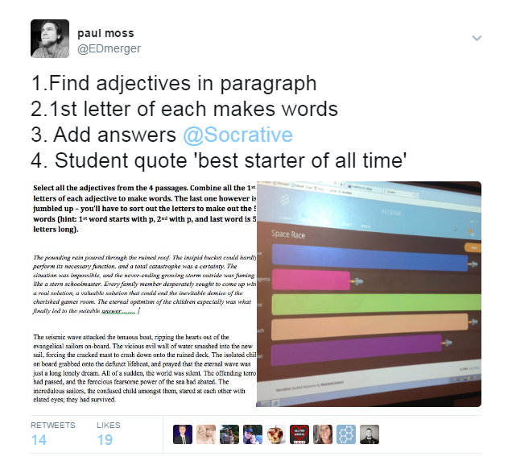
Notes:
Easy to add on Socrative. Chose short answer type, students have to precisely input answer for rocket to move. Kids really like this one.

Slide 62
SPELLING
A focus on roots, prefixes, and suffixes is a great way to develop spelling, but also an appreciation of words. You will of observe students enthralled by the links to Latin and Greek, and you will be able to utilise this interest to develop better spelling. You also youobserve their interest rise when they see how do words are built from single roots.

Slide 63
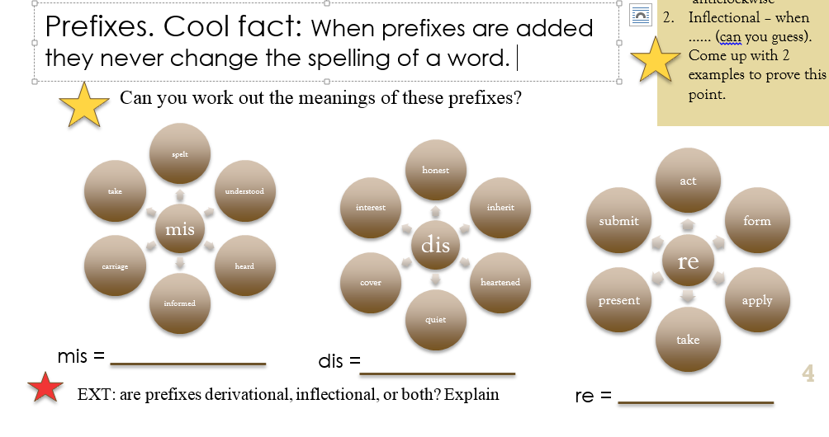
Spelling
Can you design 3 more using these prefixes:
trans
pre
im

Slide 64
PRONUNCIATION PLAY
Employs creative thinking

Slide 65
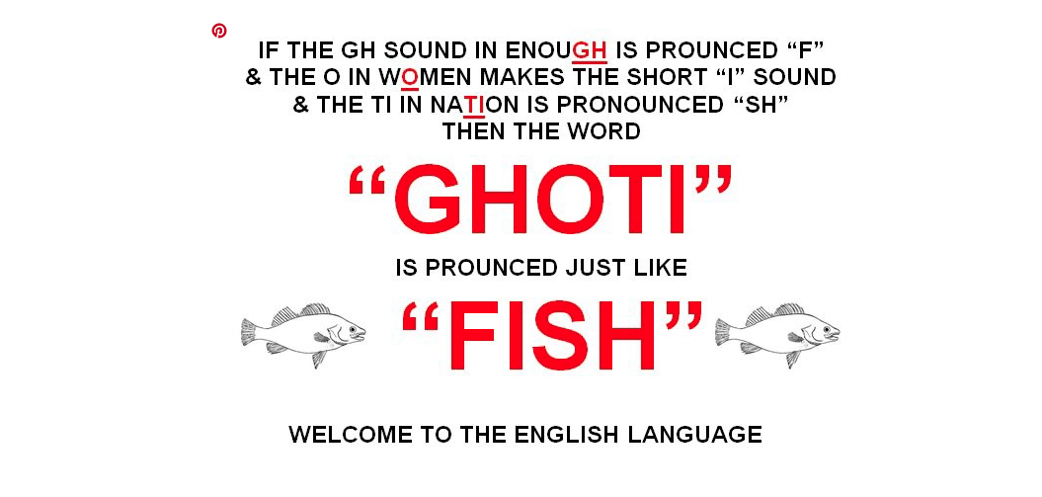
Using the example below, create a new spelling for a common word in English, and see if your peers can work out what the word is.
Notes:
Thanks to Yuniversity.com

Slide 66
Riddles
Great ways to begin lessons. Students love riddles, and they certainly wake the students’ minds. Most riddles require thinking outside the box, and this is a good lead into interesting story writing: make people surprised.
Notes:
Lots to be found at http://dumb.com/trick_questions/index.php

Slide 67
When do you stop at green and go at red?
Notes:
EATING A WATERMELON

Slide 68
The more of them you take, the more you leave behind. What are they?
Notes:
FOOTSTEPS

Slide 69
If there are three apples & you took away two, how many do you have?
Notes:
3

Slide 70
PROBLEM SOLVING
These types of activities are based on logic, and can form a good base for focusing on logos in persuasive writing. They can also form the base of creative story writing, as they can promote aspects of intrigue or mystery, where the reader has to ‘work something out’ in the plot.
Notes:
Lots to be found at http://dumb.com/trick_questions/index.php

Slide 71
Using logic
You are standing by a river with a 5-gallon jug and a 3-gallon jug but you need exactly 4 gallons of water. Using only the 2 jugs you have how can you measure out 4 gallons?
In a drawer there are 32 socks – 16 white and 16 black. If you are in the dark, and reach into the drawer, how many times do you need to reach in in order to guarantee a pair?
There are three boxes, one contains only apples, one contains only oranges, and one contains both apples and oranges. The boxes have been incorrectly labeled such that no label identifies the actual contents of the box it labels. Opening just one box, and without looking in the box, you take out one piece of fruit. By looking at the fruit, how can you immediately label all of the boxes correctly?
Notes:
Fill 5 gallon (container A), pour into 3 (container B). You now have 2 left in container A. Empty B and pour the 2 gallons into B. Fill container A, and then top up container B with 1 gallon from A, leaving 4 gallons in A.

Slide 72
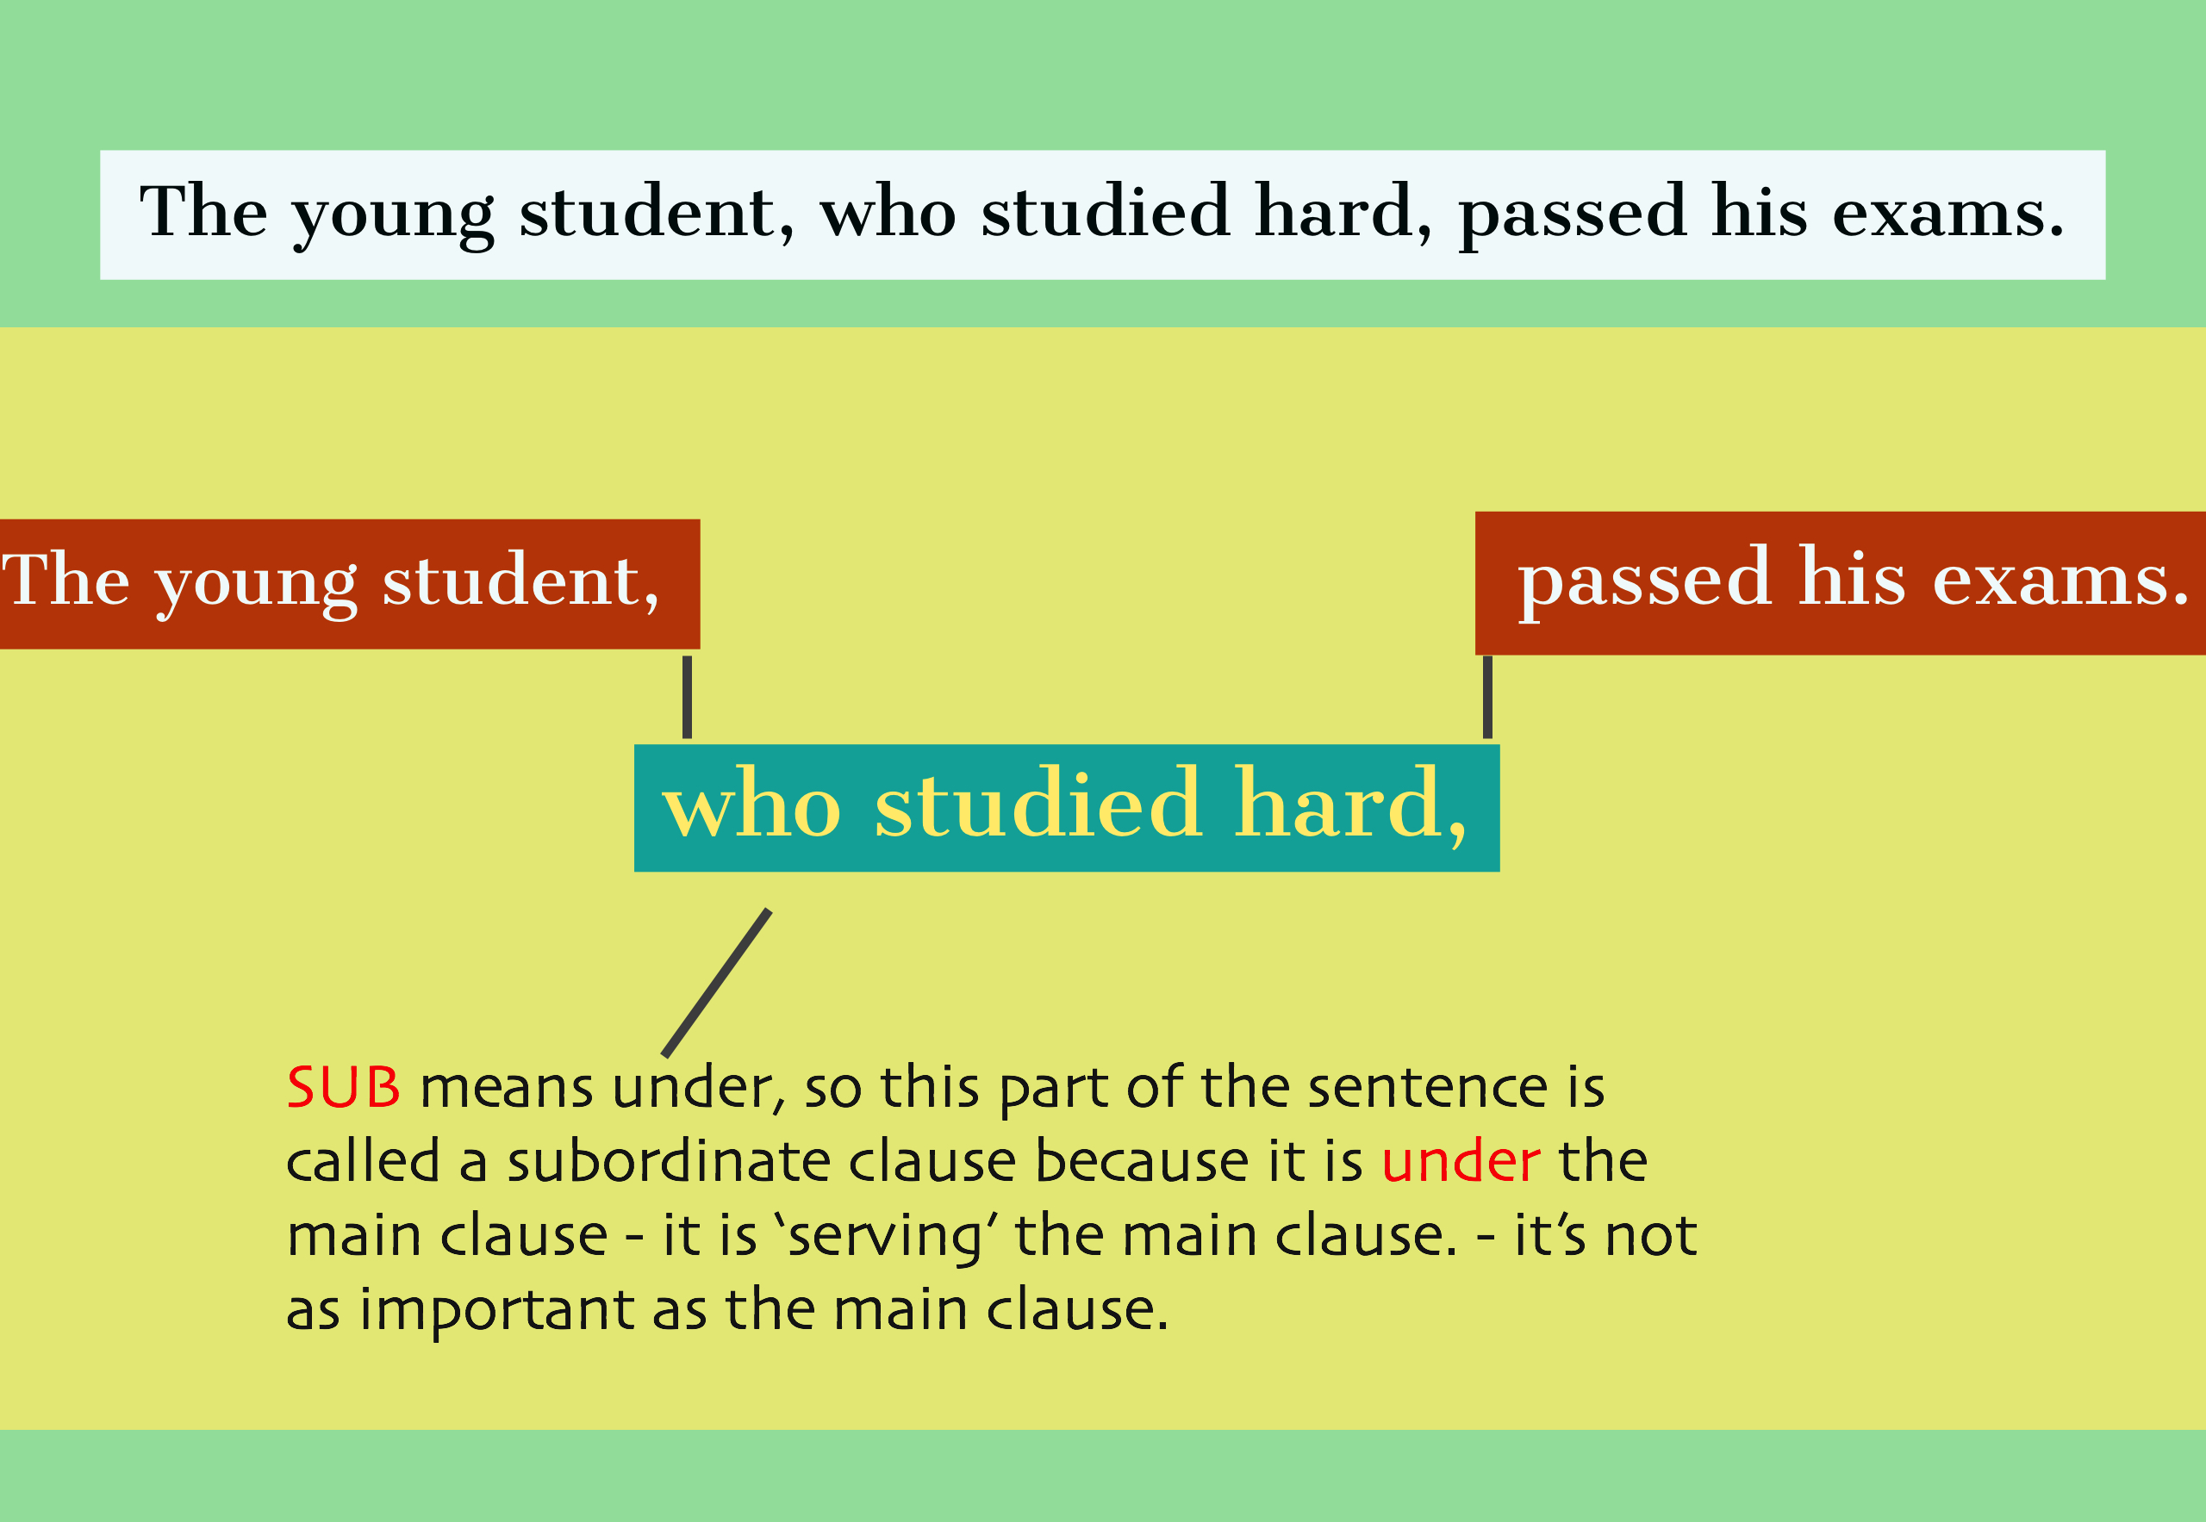
Subordinating clauses

Slide 73
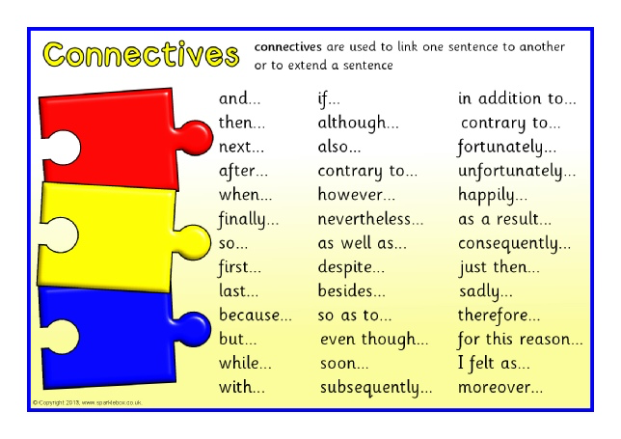
Subordinating clauses
Can you change the subordinate clause to alter the meaning of the sentence.
Can you change the position of the subordinate clause in the sentence.
Now remove the ‘who’, add a subordinating connective, and rewrite the sentence twice. Once with the subordinate clause at the beginning, and then, the second time with it at the end of the main clause.. Does it make sense now? Does it matter which connective you use?
Notes:
They can’t – the meaning won’t change because the main clause isn’t affected
They can’t – the ‘who’ must be changed
Yes they can – a multitude of possibilities exist here, but many won’t work. Good for students to play around with connectives, and pronouns too. Have students explain why some connectives don’t work.

